Slide 1
Washington State Department of Veterans Affairs
Programs and Services
Abuoh Neufville, Assistant Director
abuoh.neufville@dva.wa.gov

Slide 2
2

Slide 3
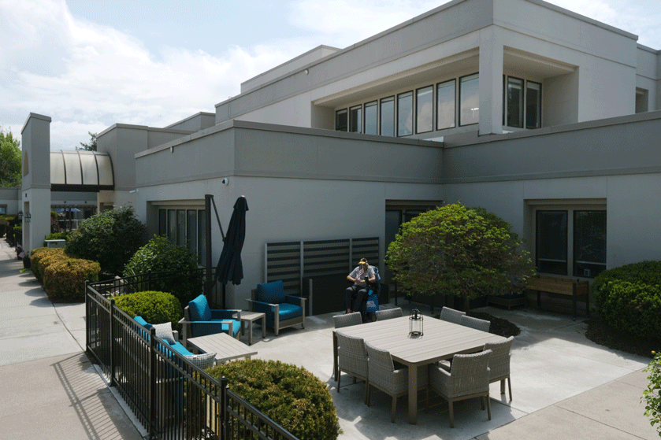
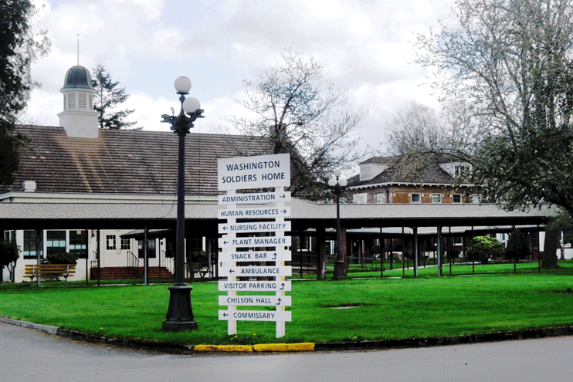
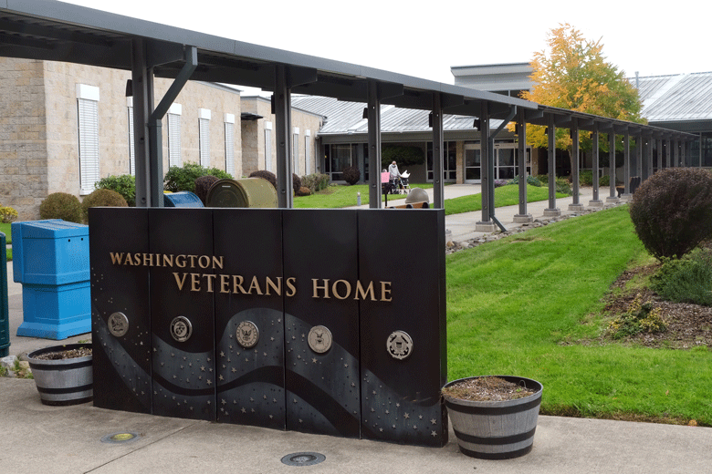
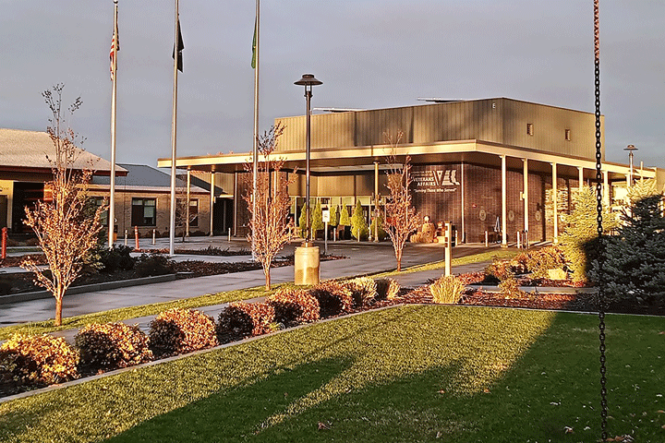
State Veterans Homes
Spokane Veterans Home
100 Residents
WA Soldiers Home
Orting
97 Residents
WA Veterans Home
Port Orchard
240 Residents
Memory Care Provided
Walla Walla Veterans Home
80 Residents
Memory Care Provided
Veterans rated 70%-100% Service Connected, or whose service-connected disability is the reason nursing care is needed, may have their nursing home care paid by the Federal VA. Residents benefit from:
Medicaid & Medicare Certified
Physical & Occupational Therapy
Recreational Activities
Social Services
Volunteer Programs
24-hour Nursing Care
Hospice
Nutritious Meals
Community Involvement
Religious Programs
Medical care & Pharmacy
Transportation
Laundry
Beauty & Barber Shops
Fishing Pond (Orting)
You may be eligible if you served at any time, in any branch of the United States Uniformed Services including the National Guard, you are a spouse of a resident, widow of an eligible veteran, or are a Gold Star Parent who lost a child serving in the armed forces.
3
Notes:
Four State Veterans Homes provide Nursing Home Level care to veterans, spouses of residents, or widows of an eligible veteran. Gold Star parents are also eligible.
Veterans Homes are located in Orting, Port Orchard, Spokane and Walla Walla. Our Homes in Port Orchard and Walla Walla also offer secure Memory Care units.
(daily rate changes as of July 1):
Veterans Homes accept payment from a variety of sources including Medicare, Medicaid, Private Insurance, and of course Private Pay. (If asked, the daily rate for care is $355 for a double room, $365 for a private room as of 7/1/2024. Rates are adjusted July 1 of each year.)
For Veterans rated 70% to 100% service connected disabled, or whose service connected disability is the reason they need nursing home care, their cost of care may be covered by the Federal VA. This means the veteran is able to keep all their other income including VA disability, retirement or social security.
We have staff members at each State Veterans Home who can answer questions about the admissions process and can also help veterans file for increases to their disability claims once they become residents.
Our Veterans Homes are committed to providing quality nursing home care and treating veterans and their family members with the dignity and respect they deserve.

Slide 4
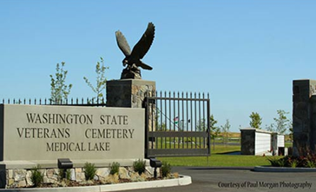
State Veterans Cemetery
Located in Medical Lake, WA the cemetery has a committal service shelter, and provides for casketed burial, columbarium niches, and burial plots to support cremations, as well as a scatter garden.
21702 West Espanola Rd
Medical Lake, WA
Eligibility mirrors that of the U.S. Department of Veterans Affairs Cemeteries.
Armed Forces License Plates help support the State Veterans Cemetery
$28 from the sale or renewal of each Armed Forces License Plate are directed to operating and maintaining the state veteran’s cemetery, and to providing programs, and services for veterans without homes, and other activities that benefit veterans
4
Notes:
Located in Medical Lake, WA the cemetery has a committal service shelter, and provides for casketed burial, columbarium niches, and burial plots to support cremations, as well as a scatter garden.
Burial in the Washington State Veterans Cemetery – Medical Lake is open to all members of the armed forces who have met a minimum active-duty service requirement and were discharged under conditions other than dishonorable. A Veteran's spouse, widow or widower, minor dependent children, and under certain conditions, unmarried adult children with disabilities may also be eligible for burial. Eligible spouses and children may be buried even if they predecease the Veteran. Members of the reserve components of the armed forces who die while on active duty or who die while on training duty, or were eligible for retired pay, may also be eligible for burial.
You can help support the State Veterans Cemetery by purchasing an Armed Forces License plate for your vehicle. $28 from the sale or renewal of each Armed Forces License Plate is directed to operating and maintaining the state veteran’s cemetery, and to providing programs, and services for veterans without homes, and other activities that benefit veterans

Slide 5
Veterans Services
Claims Assistance through Veteran Service Officers
WDVA contracts with 5 Veteran Service Organizations
African American PTSD Association
American Legion
National Association of Black Veterans Inc
Veterans of Foreign Wars
Vietnam Veterans America
WDVA has 23 County Veteran Service Officer (CVSO) agreements with 30 (out of 39) counties being served
WDVA has MOAs with the 7 (8) out of the 29 federally recognized
Indian tribes to provide VSO training and accreditation to their
Tribal VSOs
5
Notes:
We have several ways in which we assist our veterans with claims, we have 23 counties with CVSOs accredited through WDVA, 7 additional counties share VSO services from other counties and we contract with 5 nonprofit veteran service organizations, we have 7 Indian tribes with TVSO’s accredited through WDVA. There are 6 counties that contract directly with WDVA for VSO services and there are additional counties considering entering into CVSO partnerships with WDVA.

Slide 6
Veteran Service Officer Coverage % Vets in Receipt of Disability Benefits *
San Juan
15%
Whatcom
25%
State VSOs
Okanogan
31%
Ferry
36%
Pend
Oreille
31%
Skagit
28%
Island
37%
Stevens
33%
Clallam
26%
Snohomish
23%
Nonprofit VSOs
Jefferson
25%
Chelan
24%
Kitsap
41%
Douglas
24%
Kitsap
Seattle
Lincoln
33%
King
20%
Spokane
34%
Grays
Harbor
29%
King
Counties with CVSOs
Mason
37%
Grant
26%
Tacoma
Kittitas
22%
Olympia
Pierce
37%
Adams
25%
Whitman
25%
Thurston
44%
Pierce
Thurston
Pacific
23%
Lewis 30%
Franklin
34%
Garfield
41%
Shared CVSO
Yakima
28%
Benton
30%
Columbia
33%
Cowlitz
29%
Skamania
20%
Walla Walla
33%
Asotin
30%
Wahkiakum
32%
Clark
27%
Klickitat
40%
Counties without CVSOs
6
Updated July 2024
* Seattle VARO data, Jan 2023
Notes:
Veteran Service Officer Program (RCW 43.60A.237 $600K, Proviso/SB 5358 $600K): Asotin, Clallam, Island, Skamania, Stevens, Walla Walla counties
PACT Act funded state VSOs (4 FTEs): King-2, Kittitas, Skagit counties

Slide 7
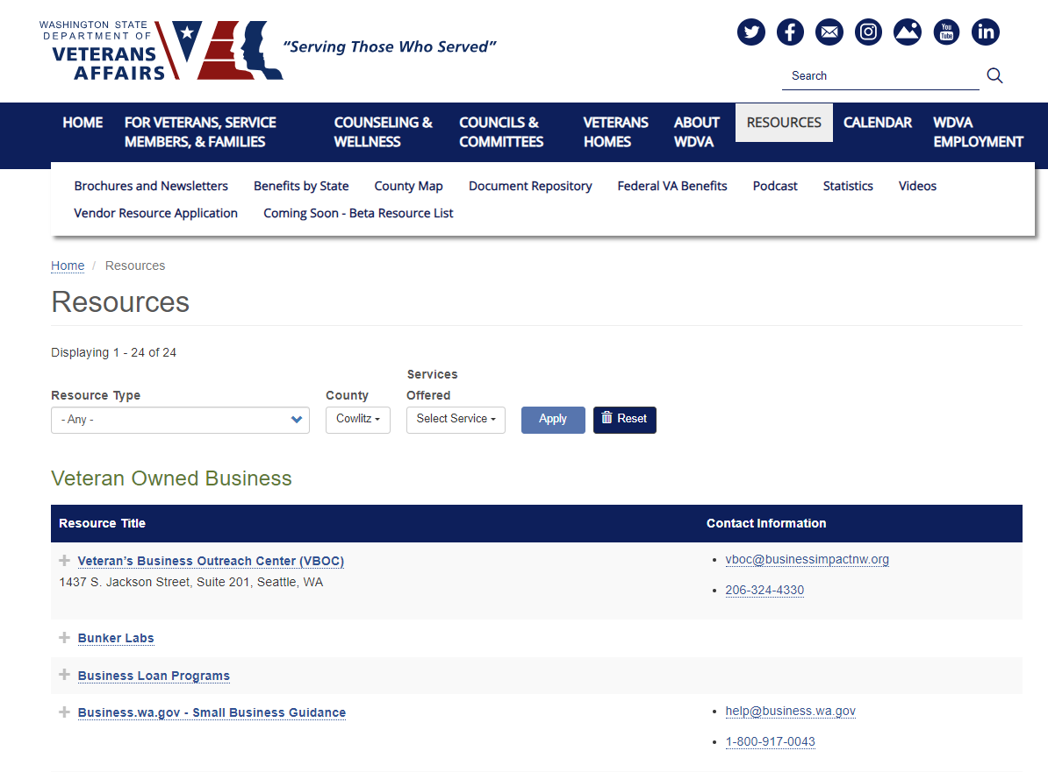
resources for veterans
7

Slide 8
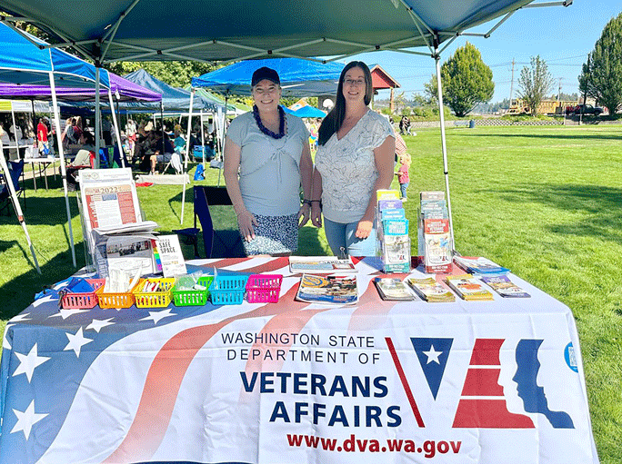
Veterans Services Continued
Veterans Innovations Program (VIP)
Assists Post 9/11 veterans facing financial hardships.
Transitioning Warrior Program (JBLM)
Provides information about all available benefits to
separating personnel from Joint Base Lewis McChord
Veterans Estate Management Program (VEMP)
VEMP offers protective payee services for veterans and family members who are incapable of managing their own financial affairs.
LGBTQ+ Veterans Outreach Coordinator
Connects LGBTQ+ veterans to benefits and assists with the upgrade of discharge status.
Service Center – 1-800-562-2308
8
Notes:
VEMP - Protective payee services for veterans and family members. The Washington State Department of Veterans Affairs Veterans Estate Management Program (VEMP) offers protective payee services for veterans and family members who are incapable of managing their own financial affairs. By assuming custody of the individual’s finances, the department ensures basic needs – such as housing, food, clothing and medical care – are provided.
Transitioning Warrior Program
In addition to all of the programs described, there are additional programs and partnerships at WDVA including partnerships that help connect veterans who are referred to us from other agencies, like DSHS, to their earned benefits.
Our new LGBTQ+ Veterans Outreach Coordinator helps connect lesbian, gay, bisexual, transgender, and queer+ veterans to their earned benefits, services, programs, resources, and information. The program also assists with the upgrade of discharge status, including for veterans who were given an other-than-honorable discharge under the Don't Ask, Don't Tell policy.
You can always reach WDVA through our toll-free number at 1-800-562-2308.

Slide 9
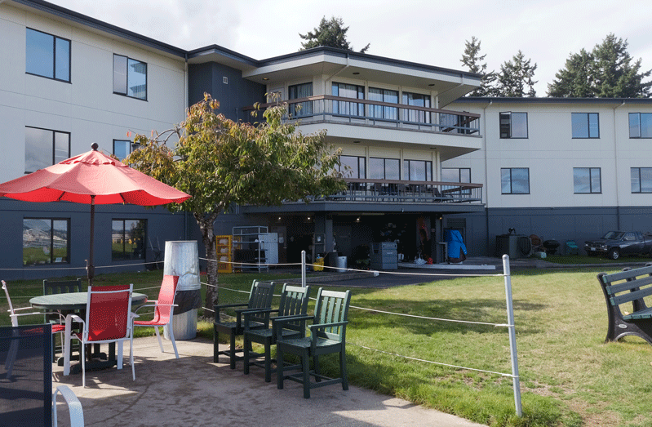
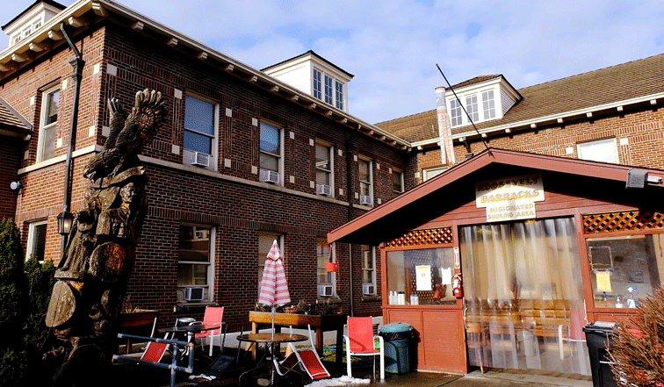
Transitional Housing Program (THP)
Transitional housing facilities in Port Orchard and Orting help veterans in need with stable housing, vocational rehabilitation, and employment.
Veterans are surrounded with supportive staff and wrap-around services that lead to successful program completion and their return to the community.
Program Goals
Increased residential stability
Greater self-determination
Increased skill level and income potential
Building 10 in Port Orchard
48 Beds
5 Beds for Medical Recuperative Care
Roosevelt Barracks / Betsy Ross Orting
62 Grant & Per Diem Beds including 52 in Roosevelt Barracks and 10 beds in Betsy Ross dedicated for women veterans
20 Beds Contract Residential
Shelter
9
Notes:
Transitional housing facilities in Port Orchard and Orting help those in need with stable housing, vocational rehabilitation, and employment.
Veterans are surrounded with staff and wrap-around services that lead to successful program completion and their return to the community.
Port Orchard: 48 Per Diem beds, 5 Medical Recuperative Care beds
Orting: 62 Per Diem beds (including 10 in Betsy Ross) & 20 Contract Residential Services beds
Explain background and what they are for the 5 Medical Recuperative Care beds.
To be eligible, veterans must: Have served in any branch of the US Armed Forces and received an honorable or general under honorable conditions discharge.
Be homeless for one or more nights, Have a desire to lead a clean and sober lifestyle, Have a desire to make meaningful life changes leading to independent living, and Be willing to undergo criminal background check.
Hypothetically speaking, if a veteran has an Other than Honorable discharge and is receiving VA disability compensation or pension, they may qualify due to the disability benefit qualifying them (added note by Heidi/Steve).
The WDVA Transitional Housing Program has a proven track record of helping veterans rediscover their self-worth, often helping them reconnect with family and friends, and helping them move on with productive and happy lives.
At our Orting Location, we also have a partnership with Quixote Communities who operates the Orting Veterans Village on our campus. The Orting Veterans Village is a permanent supportive tiny house village for 35 homeless veterans.

Slide 10
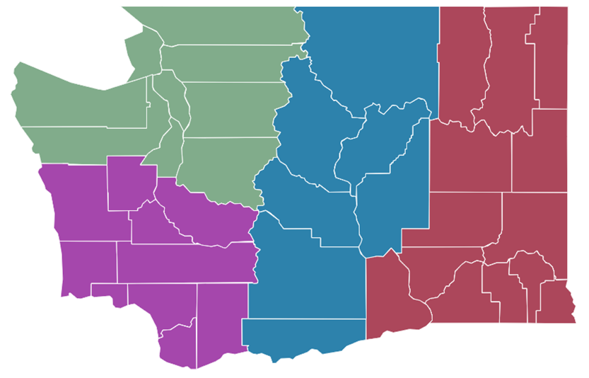
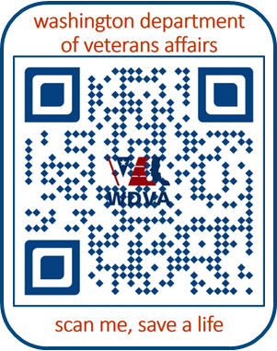
WDVA Suicide Prevention Program
Suicide Prevention Peer Team
Four (4) Regionally located Peer Specialists
Provide:
Community workshops
Suicide prevention training
Combatting stigmas
Collaboration with regional agencies & organizations serving veterans
Resource referral
For immediate help, call 9-8-8
For non-emergency questions & requests for assistance, email connect@dva.wa.gov
Northwest – Shiloh Kinney Shiloh.Kinney@dva.wa.gov
Southwest - Don Seese, MSW
Donald.Seese@dva.wa.gov
10
988 Emblem

Slide 11
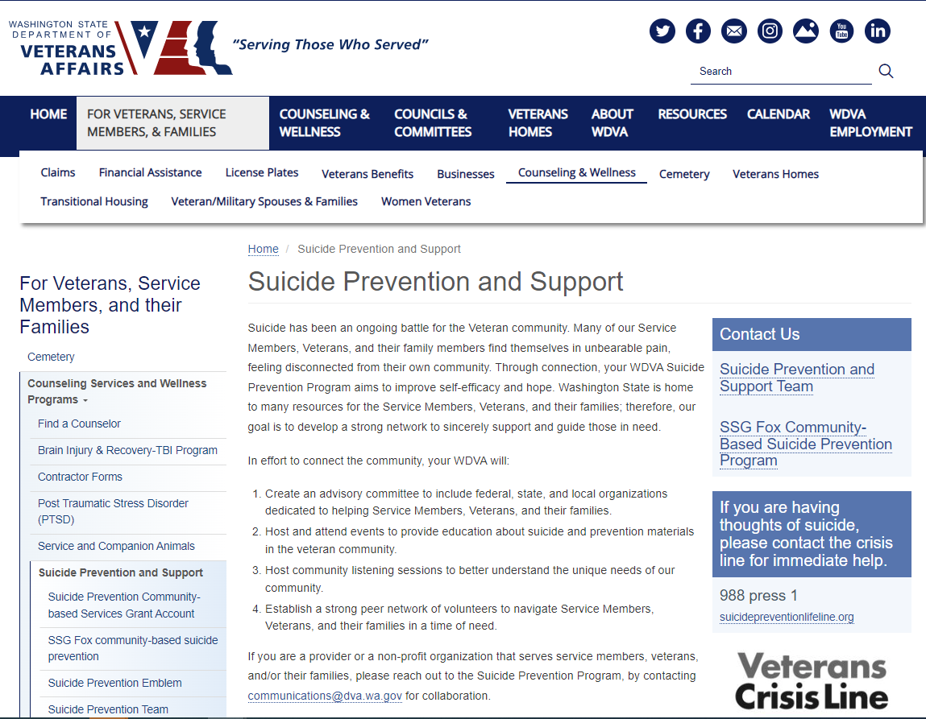
suicide prevention program
11

Slide 12
Other Counseling and Wellness Programs
WDVA Counseling Program
Contracted Licensed Mental Health Providers serve veterans and families experiencing mental health challenges to include Post-Traumatic Stress, Military Sexual Trauma, or other military related issues.
Veterans Training Support Center
No-cost training provided each month on a variety of topics.
Sign up at www.dva.wa.gov.
Brain Injury & Recovery Program
Supports and represents every veteran in WA that has incurred a Brain Injury.
12
Notes:
WDVA’s Contracted Licensed Mental Health Providers serve veterans and families by providing no cost counseling services in Washington State communities. Currently we have 41 contracted community providers. Veterans and families can self-refer to these counselors and can find a list on the WDVA website.
The Veterans Training Support Center (VTSC) offers no-cost training thanks to a grant from King County Veterans Services. While the training is targeted toward King County, they are available virtually to veterans, families, and those serving veterans and families in Washington State.
Our Traumatic Brain Injury Program provides one on one support, resources and referrals. In addition, the program supports the groups and agencies that are out there doing great things for our vets including providing training and advice to any agency, group, summit, or conference.
The Suicide Prevention and Support Program is a combination of a national initiative known as the Governor’s Challenge to End Veteran Suicide and legislation passed by the Washington State legislature. With the assistance of an advisory committee made up of federal, state and local partners, this program aims to help veterans and families before they experience a crisis. If your organization would like to join this effort, please let us know!

Slide 13
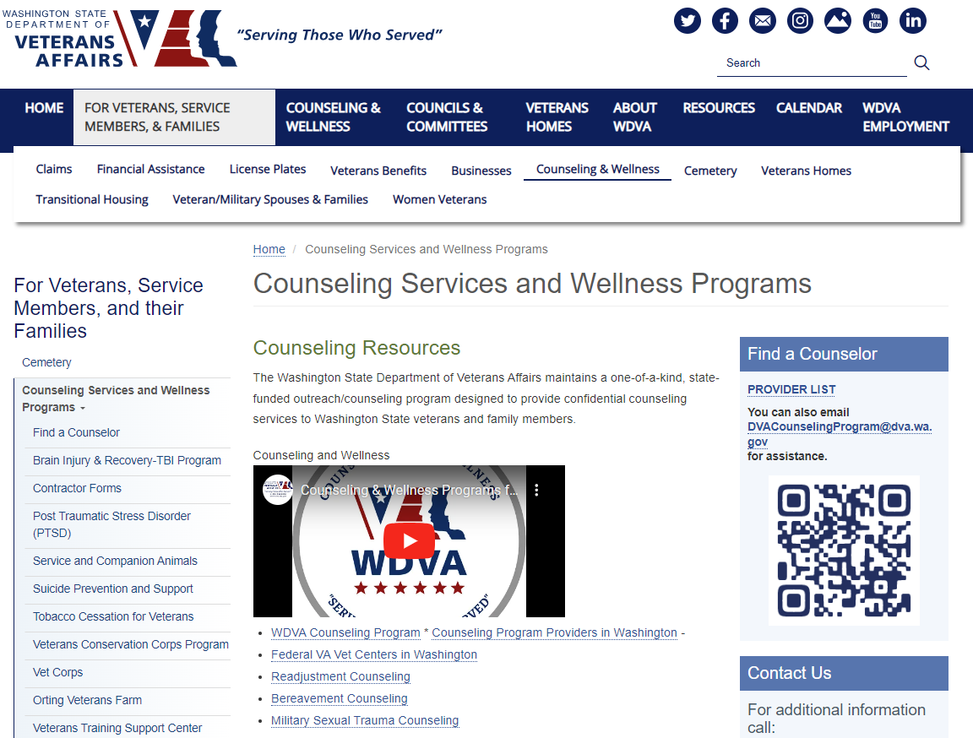
Counseling programs
13

Slide 14
Transition, Readiness & Family Services
WA State Military Transition and Readiness Council (WSMTRC)
Partnership that supports service members and families to successfully transition into civilian careers.
Military Spouse Initiatives
Policy and program advocacy for military spouses (employment, credential portability, childcare, etc.). Convenes cross-sector workgroups. Shares resources and provides individual consultation.
Apprenticeship Program
Assists veterans in connecting with registered apprenticeships and other career-connected learning. Convenes cross-sector apprenticeship workgroup. Veterans gain marketable skills, make a livable wage, and can use Veterans Education Benefits as part of their apprenticeship.
Veteran-Owned Business (VOB) Program
Recruits and enrolls Veteran and service members in VOB Certification and Linked
Deposit programs. Convenes cross-sector entrepreneur business development
workgroup.
14
Notes:
The Washington State Military Transition and Readiness Council (WSMTRC) is a cross-jurisdictional and cross-sector partnership that supports military service members and families successfully transition into civilian careers.
The Military Spouse Outreach Initiative connects military spouses with resources to help them transition to a new duty station. The military spouse coordinator works with spouses to provide information on things like how to transfer professional licenses so they can get a job more quickly and Washington’s rules for residency in colleges and universities. The coordinator also convenes workgroups on issues of importance to military spouses such as childcare and housing, to name a few.
Apprenticeship for Veterans - Apprenticeship is a combination of on-the-job training (OJT) and related classroom instruction under the supervision of a journey-level craft person or trade professional in which workers learn the practical and theoretical aspects of a highly skilled occupation.
Businesses certified as Veteran or Service Member Owned are listed on a website so public agencies who are asked to do more purchasing from veteran owned businesses, can find them. The Governor has asked state agencies to do 5% of their purchasing with VOBs so it’s very important that we get the word out about the program and get more businesses certified! Businesses must be owned by an honorably discharged veteran, although a 50/50 split is ok if a veteran and their spouse who own the business together, the business must also be incorporated or based in WA state.

Slide 15
Definition of a Veteran for the purpose of State veterans' benefits
SSHB 2014 – RCW 41.04.005, RCW 41.04.007
State definition of “veteran,” expanding state veterans’ benefits to any veteran who is already eligible for federal Department of Veterans Affairs monetary benefits
Creates eligibility for state benefits for veterans who were separated with less than honorable characterizations of service due solely to sexual orientation, gender identity, or gender expression or actions or statements related to sexual orientation, gender identity, or gender expression, regardless of characterization of service
15

Slide 16
Other State Benefits
Reduced Fishing/Hunting License (DV 30%+)
State Park Passes (DV 30%+)
Federal Park Passes (all veterans)
Reduced Public Transportation Fees (DV 40%+)
Long Term Care Exemption (DV 70%+)
Reduced Tuition at Public Colleges and Universities
Free License Plates for 100% disabled veterans and Gold Star spouses and parents.
Reduced Property Taxes (DV 80%+), contact the county assessor for more information
Recording of Discharges
DD 214 Database
Governor’s Welcome Home Letters
County Veterans Assistance Funds
16

Slide 17
Connect to Your WDVA!
www.dva.wa.gov
Service Center – 1-800-562-2308
Veterans Homes Information
1-877-VETS-R-US / 1-877-838-7787
Veteran Services
Steven J. Gill – 360-789-5886
Counseling and Wellness
Keith Meyer – 360-725-2220
Cemetery
Rudy Lopez – 509-299-6280
Transitional Housing Program
(M-F 8:30-4:30) thp@dva.wa.gov
Building 10 Port Orchard, WA 360-895-4371
Roosevelt Barracks Orting, WA 253-263-0735
Follow us on Social Media!
Facebook (WSDVA):
www.facebook.com/wsdva
Twitter (WDVA):
https://twitter.com/WDVA
LinkedIn:
www.linkedin.com/company/Washington-state-department-of-veterans-affairs-recruiting
Instagram (WSDVA):
https://www.Instagram.com/wsdva
YouTube: Washington Department of
Veterans Affairs or WDVA
https://www.youtube.com/user/
WAVeteransAffairs/video
17
Notes:
And finally, we have Call Centers and Service Hubs throughout the state. You can always reach WDVA through our toll-free number at 1-800-562-2308.

Slide 18
Thank You
Abuoh Neufville, Assistant Director
abuoh.neufville@dva.wa.gov

Slide 19
Counseling and Wellness Programs
WDVA Counseling Program
Contracted Licensed Mental Health Providers serve veterans and families experiencing Post-Traumatic Stress, Military Sexual Trauma, or other military related issues.
Veterans Training Support Center
No-cost training provided each month on a variety of topics. Sign up at www.dva.wa.gov
Brain Injury and Recovery Program
Supports and represents every veteran in WA that has incurred
a Brain Injury.
19
Notes:
WDVA’s Contracted Licensed Mental Health Providers serve veterans and families by providing no cost counseling services in Washington State communities. Currently we have 41 contracted community providers. Veterans and families can self-refer to these counselors and can find a list on the WDVA website.
The Veterans Training Support Center (VTSC) offers no-cost training thanks to a grant from King County Veterans Services. While the training is targeted toward King County, they are available virtually to veterans, families, and those serving veterans and families in Washington State.
Our Brain Injury & Recovery Program provides one on one support, resources and referrals. In addition, the program supports the groups and agencies that are out there doing great things for our vets including providing training and advice to any agency, group, summit, or conference.

Slide 20
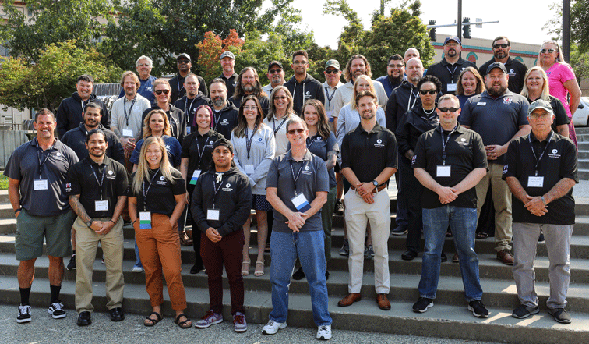
Counseling and Wellness Programs Continued
Vet Corps
Through training and peer-to-peer support, Vet Corps Member’s
support student veterans, veterans in the community, and
military families by building on shared experiences and creating
supportive relationships.
Veterans Peer Corps
Provides training to community members interested in serving as Peer Mentors.
Veterans Conservation Corps
Provides opportunities for veterans to connect with nature in their own way while restoring and cultivating Washington’s natural resources.
Veterans Farm at Orting
Offers a place where veterans can lease fertile farmland, attend classes, volunteer and generally support a growing community.
Tobacco Cessation Program
Helps connect veterans and military families to resources that help decrease tobacco dependence, increase cessation efforts, and support for staying stopped.
20
Notes:
The Vet Corps program stations individuals, referred as Vet Corps Members (VCM’s), at colleges, universities, and community organizations throughout Washington state. The program is specifically designed to help veterans and their family members navigate their journey as they transition from military to civilian/collegiate/or community life. The program also ensures veterans are aware of the many resources available to them and helps connect them to their earned benefits.
The Veterans Peer Corps (VPC) Provides training to community members interested in serving as Peer Mentors. Many veterans have a need for support services, including peer-to-peer interaction and connections. The Veterans Peer Corps gives veterans places to gather, share experiences and stories, heal together, and ultimately create a sense of a Veteran Community within their own community.
The Veterans Conservation Corps (VCC) Provides opportunities for veterans to connect with nature in their own way while restoring and cultivating Washington’s natural resources. It also offers Internships for Veterans through partnerships with community organizations across the state.
The Veterans Farm at Orting is situated on the Soldiers Home campus as the base of Mount Rainer in the Orting Valley. Offering a place where veterans can lease fertile farmland, attend classes, volunteer and or generally support a growing community. Veterans interested in leasing land at the Veterans farm pay an annual fee of only $50 which entitles Veterans to use the land as they see fit, which includes irrigation, greenhouse, and cold storage.
The Veterans Commercial Tobacco Cessation Program. In partnership with Washington State Department of Health and funded by a grant from The Centers for Disease Control (CDC), the Veterans Commercial Tobacco Cessation Program (DVA) exists to connect Washington’s veterans and military families to resources that help decrease tobacco dependence, increase cessation efforts, and provide support for staying stopped.

Slide 21
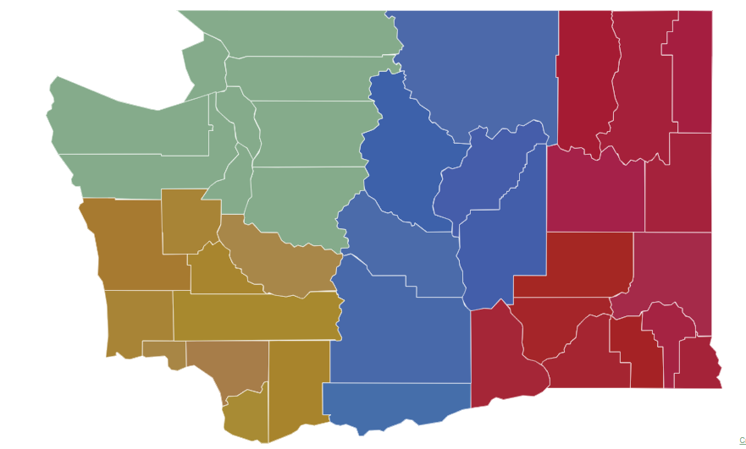
Suicide Prevention & Support Program
Includes Governor’s Challenge to Prevent Suicide among Servicemembers, Veterans, and Families (SMVF)
WA State Legislation
Community-Based Services Grant
Veteran & Military Member Suicide Prevention Account
Military & Veteran Resource Database & Web Application
Educational Materials for Providers
Suicide-Safer Homes Taskforce
Prevent Veteran Suicide Emblem
Suicide Prevention Peer Team
Regionally located to provide:
Community workshops
Collaboration with regional agencies & organizations serving
veterans
Resource referral
For Non-Emergency Questions/Requests for Assistant Email: Connect@DVA.wa.gov
Also see https://dva.wa.gov/SP for more information!
New Suicide Prevention License Plate Emblem
21
Notes:
The Suicide Prevention and Support Program is a combination of a national initiative known as the Governor’s Challenge to End Veteran Suicide, the Staff Sergeant Fox VA Grant and legislation passed by the Washington State legislature. With the assistance of an advisory committee made up of federal, state and local partners, this program aims to help veterans & families before they experience a crisis.

Slide 22
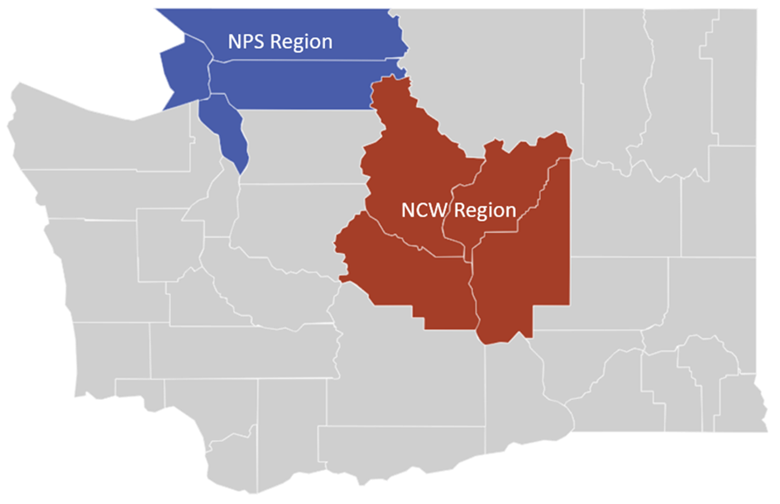
VA Staff Sergeant Fox Suicide Prevention Grant Program
Providing earlier identification and intervention for Veterans with suicide risk factors. Veterans are connected to programs such as VA Health Care, compensation or pension payments, counseling, peer support and other community resources.
Services:
Suicide prevention/ intervention.
Outreach and education on suicide prevention, peer support, and wrap-around services available throughout the state.
Peer Support Case Management. Screening and Eligibility Referrals and warm handoffs to resources.
22
Notes:
WDVA continues to seek opportunities across the entire resource spectrum to uniquely position itself to provide necessary program and services.

