Slide 1
OH FRAK, WE GOTTA DO TAXES?
How to avoid suspension revocation, and back taxes

Slide 2
LEARNING OBJECTIVES
TO UNDERSTAND AND FULFILL OBLIGATIONS TO THE IRS
UNDERSTAND WHAT IT MEANS TO BE REVOKED, SUSPENDED, DELINQUENT AND HOW TO FIX IT
TO UNDERSTAND WHY POST BECOME DELINQUENT

Slide 3
INTERNAL REVENUE SERVICE
Responsible for
collection of federal taxes
enforcement of tax laws (Internal Revenue Code)
conducting audits to ensure
taxpayers are claiming or paying what is owed
not cutting corners or hiding assets and income
Grants tax-exempt status in accordance with IRC

Slide 4
INTERNAL REVENUE CODE
I.R.C. § 501(c)(19) — A post or organization of past or present members of the Armed Forces of the United States, or an auxiliary unit or society of, or a trust or foundation for, any such post or organization—
I.R.C. § 501(c)(19)(A) — organized in the United States or any of its possessions,

Slide 5
INTERNAL REVENUE CODE
I.R.C. § 501(c)(19)(B) — at least 75 percent of the members of which are past or present members of the Armed Forces of the United States and substantially all of the other members of which are individuals who are cadets or are spouses, widows, widowers, ancestors, or lineal descendants of past or present members of the Armed Forces of the United States or of cadets, and

Slide 6
INTERNAL REVENUE CODE
I.R.C. § 501(c)(19)(C) — no part of the net earnings of which inures to the benefit of any private shareholder or individual.

Slide 7
IRS - OBLIGATIONS
Form: 990 series (990, 990-EZ, 990-N) free to file
990 Gross receipts > $200,000 Total assets > $500,000
990-EZ Gross receipts > $200,000 Total assets < $500,000
990-N Gross receipts < $50,000

Slide 8
IRS - DEADLINES
Deadline for all 990 series forms
- Annual
- 15th day of 5th month after end of fiscal year
- free to file
- Fiscal year is 1/1/22 to 12/31/22
- Due date = 5/15/23
- Fiscal year is 7/1/22 to 6/30/23
- Due date = 11/15/23
- Use Form 8868 to request a 6-month extension
- Auto-revocation if not filed for three consecutive years

Slide 9
WHY POST BECOME DELINQUENT
Loss of corporate knowledge – sickness or death
Lack of corporate knowledge – poor or no turnover
Lack of training
No schedule posted for items due
Lazy – not my problem – someone else will do
I thought the Bookkeeper, CPA was doing it.

Slide 10
LOSS OF TAX EXEMPT STATUS
Your nonprofit is no longer exempt from federal income tax.
You may have to pay corporate income tax on annual revenue.
Your nonprofit will not be listed in on the IRS list of organizations eligible to receive tax-deductible charitable contributions.

Slide 11
LOSS OF TAX EXEMPT STATUS
It means that private foundations are WILL NOT to give a grant
directly to your nonprofit that has lost its tax-exempt status, because federal tax law imposes an excise tax on grants made to organizations that are not tax-exempt.

Slide 12
HOW TO FIX YOUR STATUS
Must apply for reinstatement
1. Streamlined retroactive reinstatement (within 15 months)
990-EZ or 990-N filers
1024 or 1024-A
User fee
No penalty if reinstated

Slide 13
HOW TO FIX YOUR STATUS
2. Retroactive reinstatement process (within 15 months)
990 filers
1024 or 1024-A
User fee
3. Retroactive reinstatement (after 15 months)
Same as #2
Must file reasonable cause statement for failure to file

Slide 14
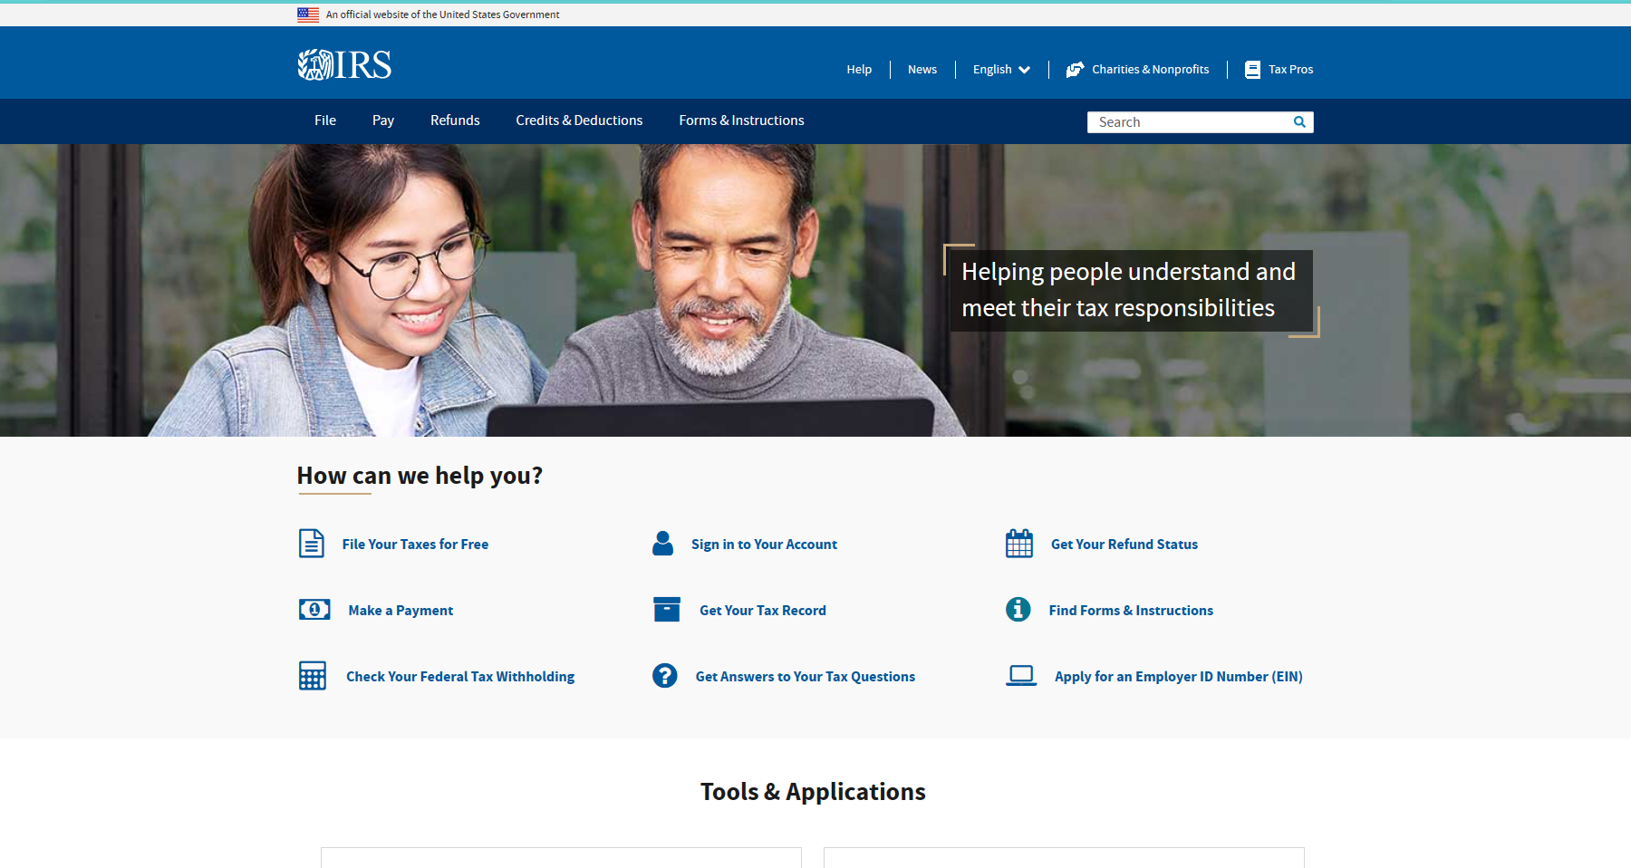
irs.gov

Slide 15
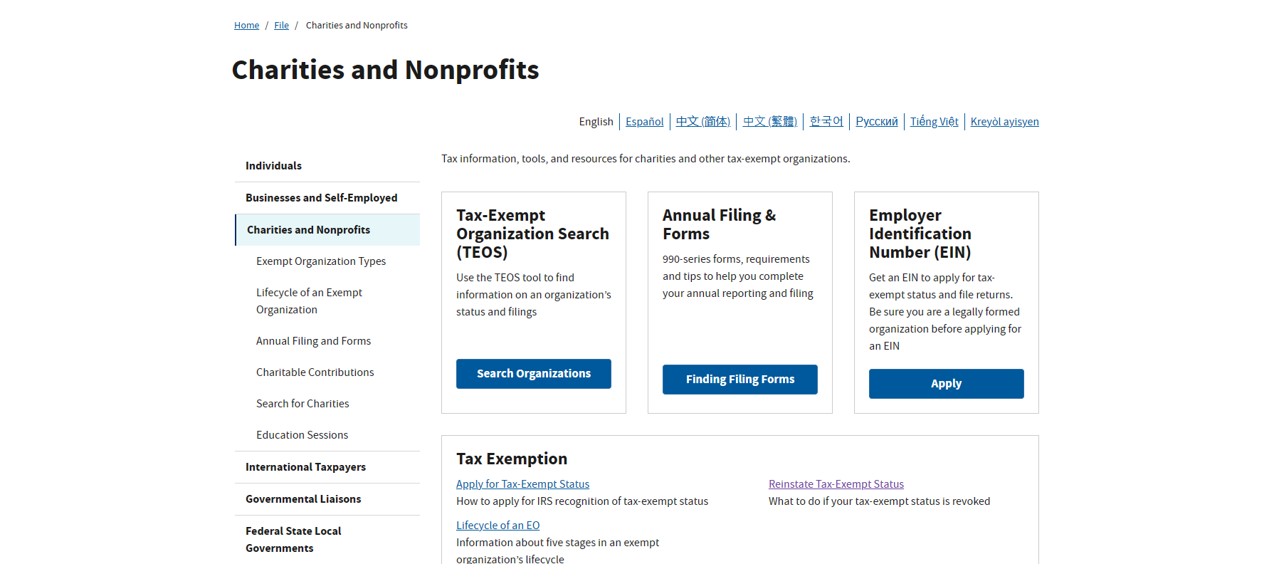

Slide 16
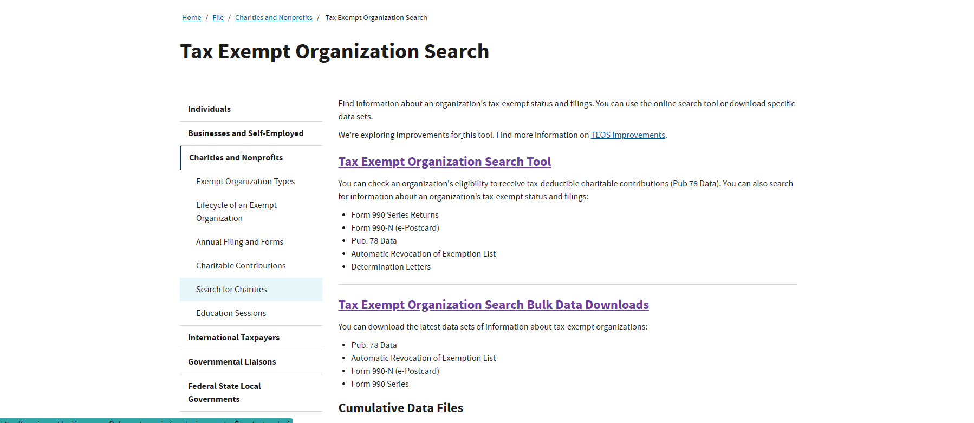

Slide 17
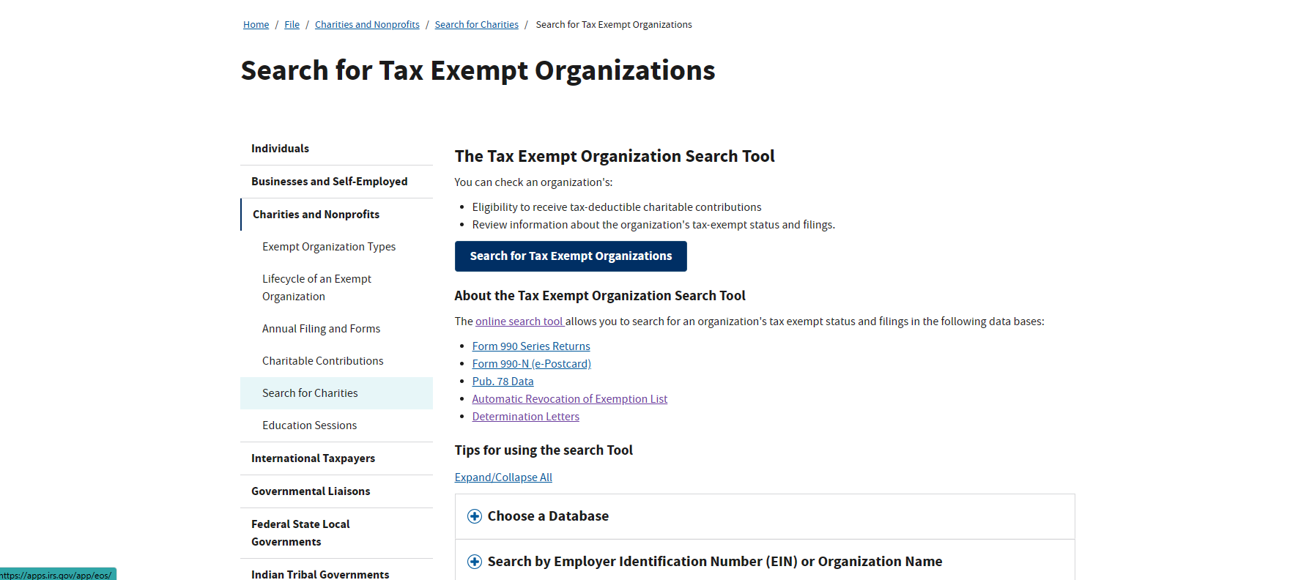

Slide 20
Fini
TAKE CARE OF YOUR TAX RESPONSIBILITIES SO THAT YOU CAN RECEIVE GRANTS AND LEGALLY RAISE TAX FREE FUNDS
DON’T FORGET OBLIGATIONS YOU MAY HAVE TO YOUR STATE AS WELL

