Slide 1
MyLegion.org
Administrative Tasks
Reports – Labels – Letters
The American Legion
Sons of The American Legion
February 2024
Notes:
MyLegion is The American Legion’s membership website. Through MyLegion, members of The American Legion and Sons of the American Legion can view and manage their membership on file at National Headquarters. Adjutants and commanders, through their individual accounts, will have a My Groups area to assist with post and squadron reports and administrative tasks.

Slide 2
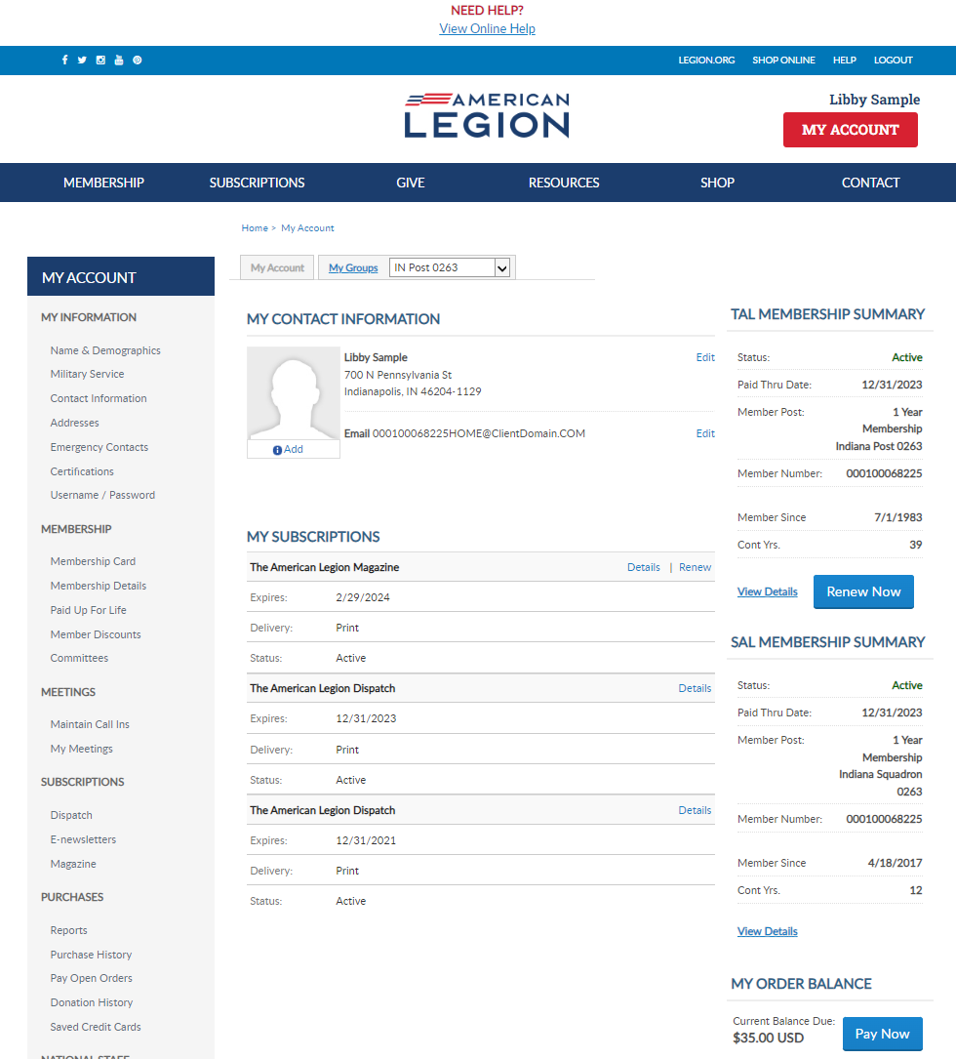
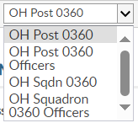
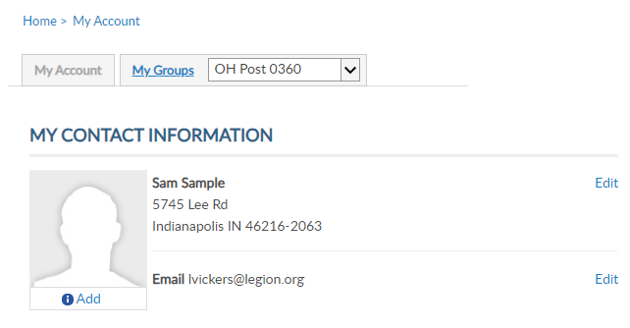
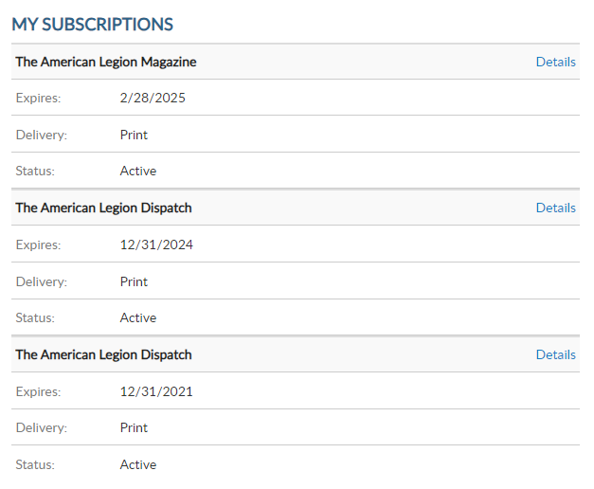
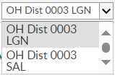
Post Adj & Cmdr
1
2
3
4
Sqdn Adj & Cmdr
primaryemail@outlook.com
000123456789
Dist/Cty Adj & Cmdr
000123456789
Notes:
Log into MyLegion and proceed to the My Groups menu. Adjutants and Commanders, from their individual account will have a My Groups menu. The group menu may vary. <1> Post adjutants will have a group for their <2> post, <3> post officers, <4> squadron, <5> and squadron officers. Squadron adjutants and commanders <6> will have a squadron and squadron officer’s group. District and county do not have officer groups. <7> Officer groups are not used for administrative actions. The offices group displays officers on file. Officer updates are updated through your department using the officer’s certification form.

Slide 3
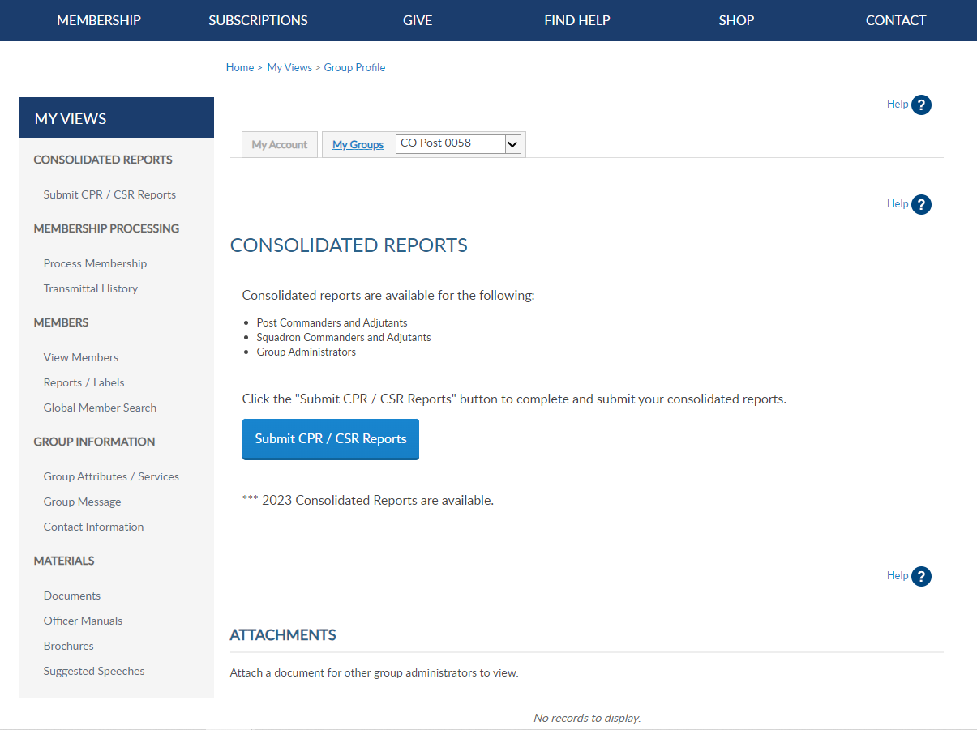
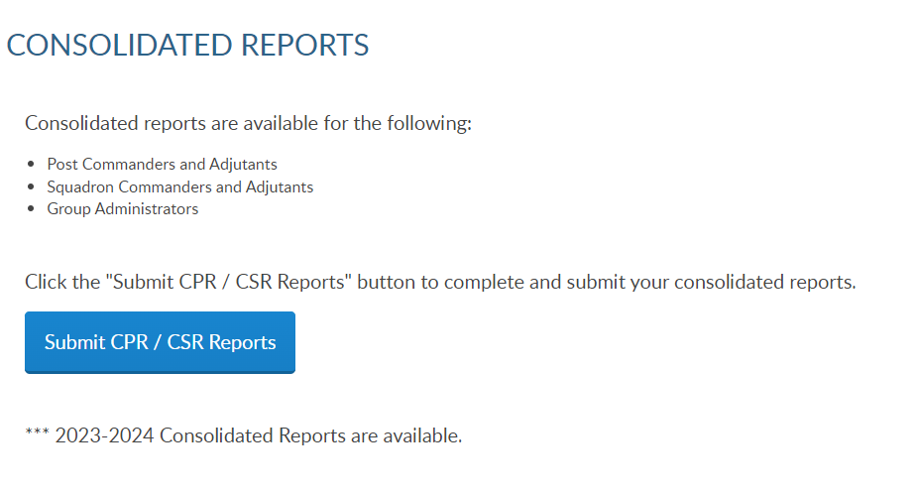
Notes:
Reports and Labels are found on the group profile window. Clicking on group profile will direct you to this main dashboard screen. The My Views menu on the left <1> has links to administrative tools, reports and labels. In this presentation we will focus on reports and labels. <2>

Slide 4
Notes:
Consolidated reports can be accessed from the left menu or click on the Submit CPR/CSR Reports link.

Slide 5
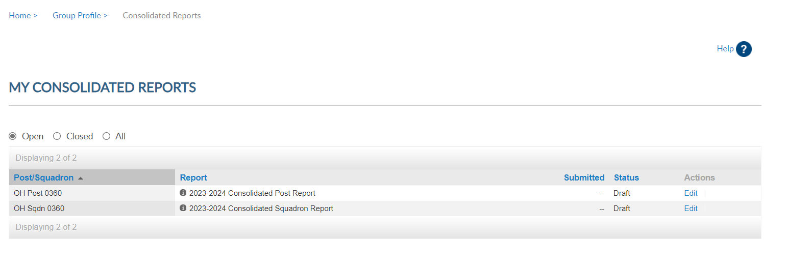
Reports submitted online do not send a paper report.
Notes:
There are 3 view areas in consolidated reports. Open includes the current report available to enter data.
There is only one open report for the reporting year. When available, you can edit the report until it is finalized or the final submission deadline. Once, finalized the report is moved to Submitted and the edit link is no longer available.
To enter information in the report, click Edit. <1> If you submit online, you do not need to mail a paper form. The department has access to submitted report data.

Slide 6
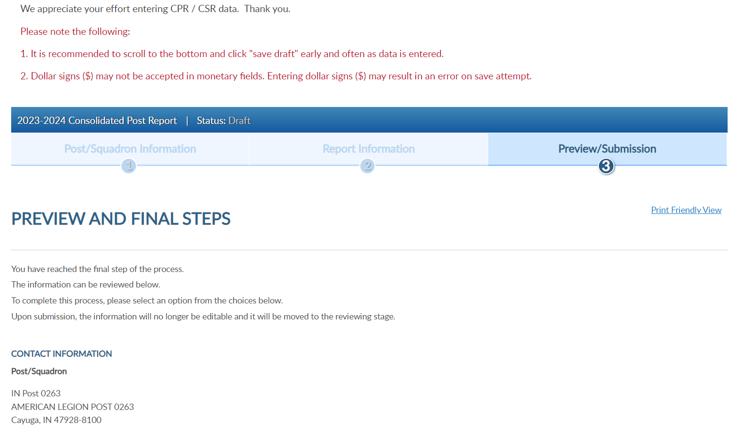
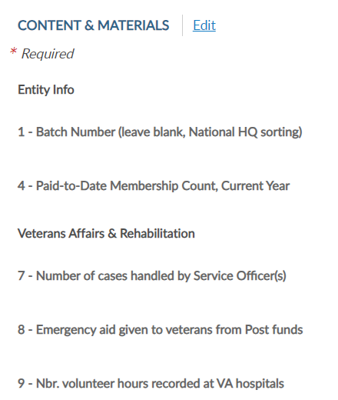
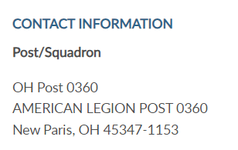
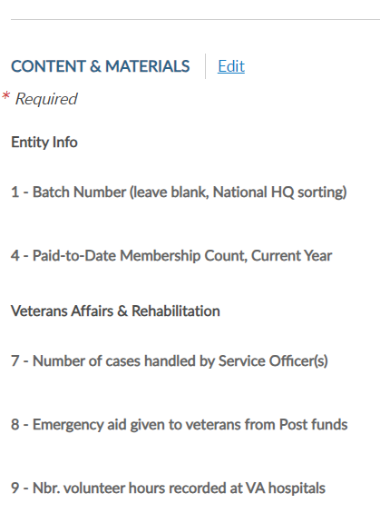
Notes:
Note the following:. It is recommended to scroll to the bottom and click “Save Draft” early and often as data is entered. Some fields may not accept the dollar sign and may result in an error. Click edit to open the fillable form. <1>

Slide 7
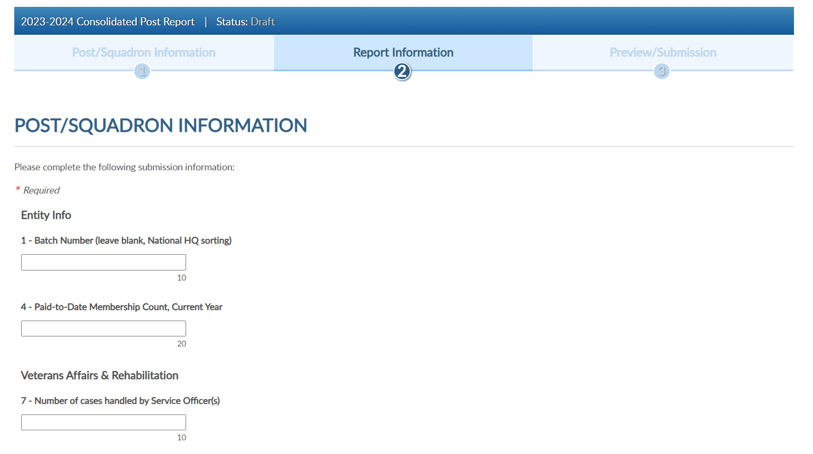
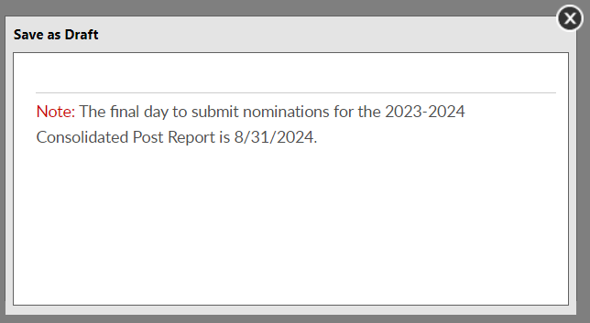
Notes:
When your entries are complete scroll to the bottom of the page to save a draft or finalize the report.
To save and return to the form later, choose Save as Draft. <1> the draft must be finalized by August 31, 2024.

Slide 8
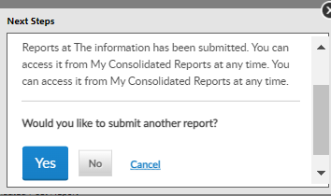
Notes:
To finalize the report, click Next. and Submit Final. You will receive a notification the report is submitted. <1>
Note, once the report is finalized it is saved as a submitted report. You will not be able to add data once submitted. If you plan to make additional updates, click Save as Draft and finalize by the due date.
This report does not need to be mailed if completed online.

Slide 9
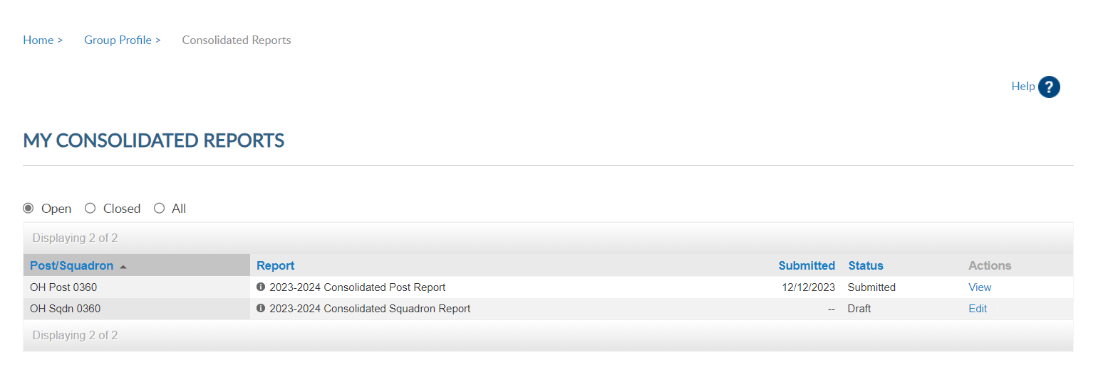
Notes:
Current reports will display in Open until the reporting deadline. They also display in All areas. <1> <2> Click “edit” to complete the report. <3> and View to view and print.

Slide 10
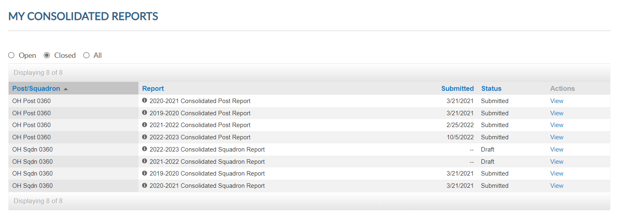
Notes:
Closed reports are previous reports from the 2020-2021. <2> Click “view” to view and print the report.

Slide 11
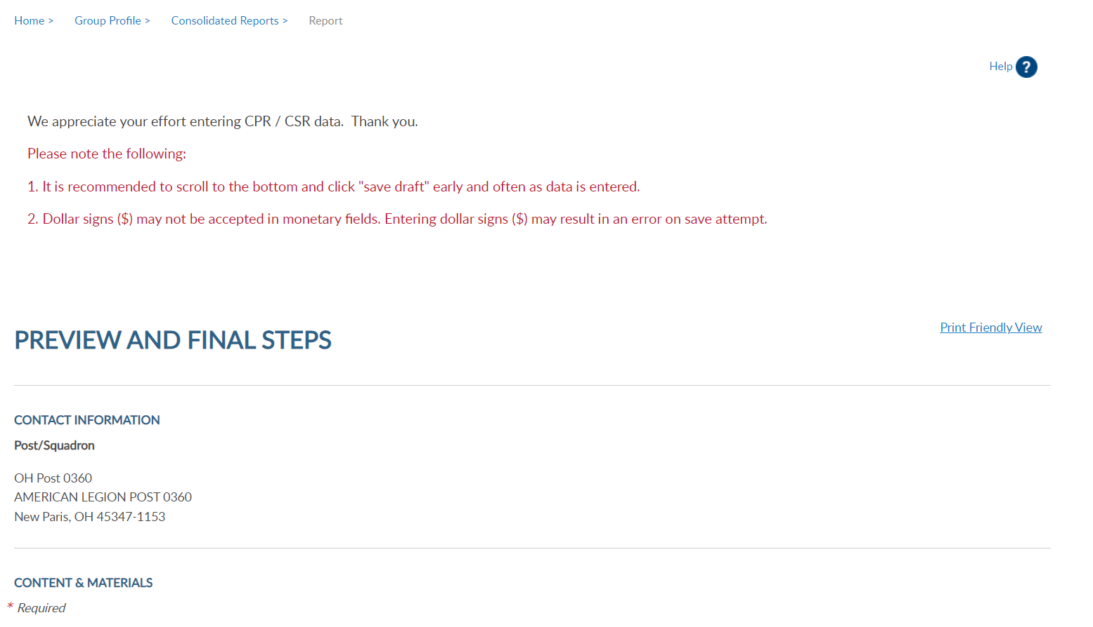
Notes:
Select Print Friendly View to advance to Print. This allows you to print the report as a PDF document.

Slide 12
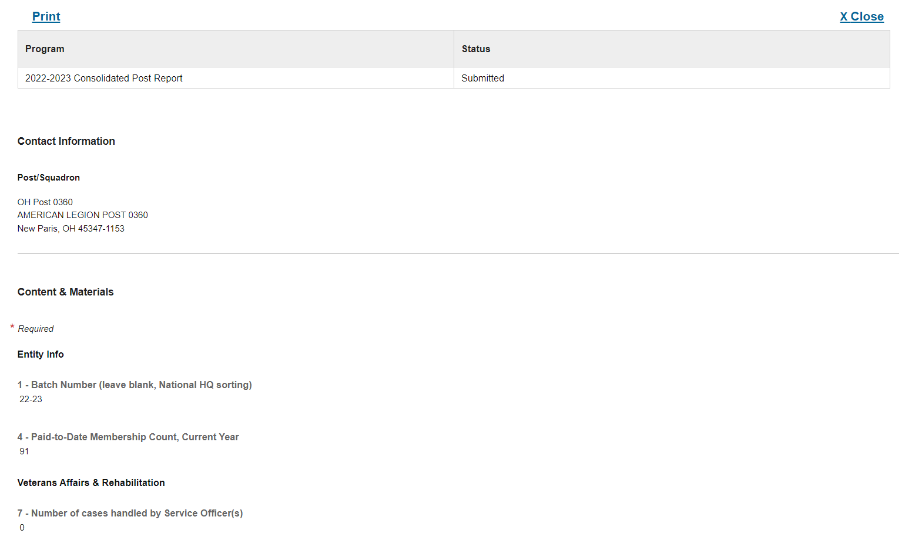
Notes:
Select Print to print the report. <1> Close to exit and return Group Profile page.

Slide 13
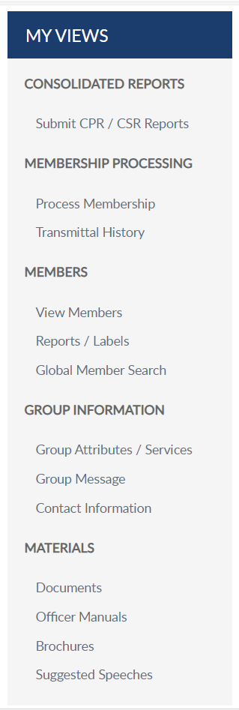
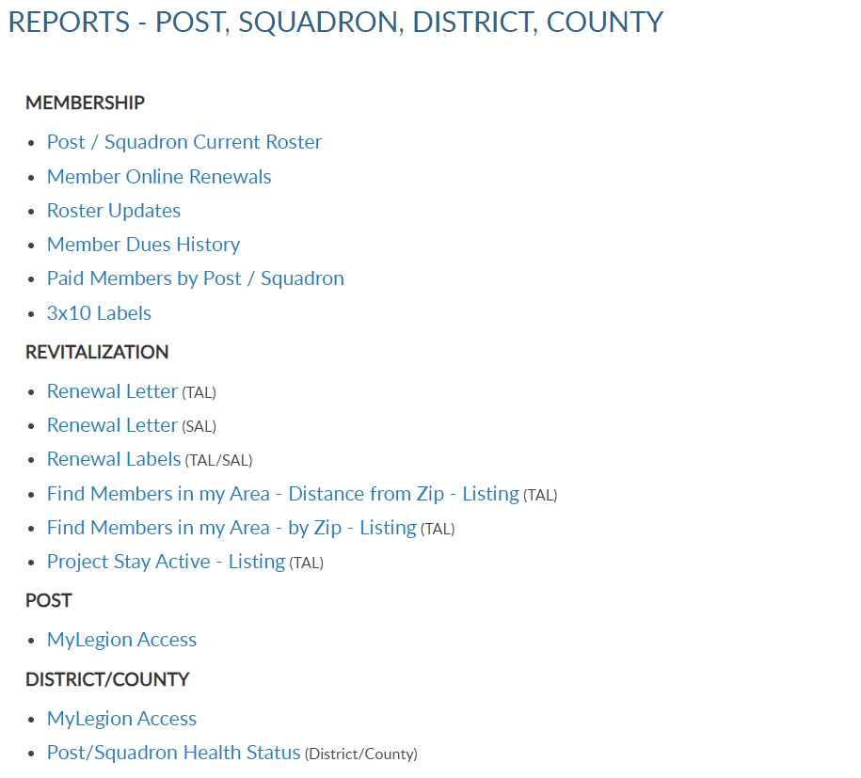
Reports and Labels
Notes:
Reports play a vital role when tracking membership. MyLegion offers a variety of reports, labels and letters.
<1> The post/squadron current roster listing includes current members of your group. Members who have transferred out, are not included in this listing. To view members who have transferred out that have paid to your post, generate a Paid Members By Post/Squadron report.
All Reports include post and squadron membership assigned to your group.

Slide 14
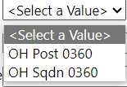
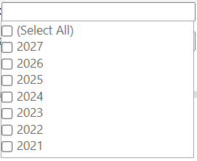
Current Roster
Displays members who are currently assigned to your post. Includes expired and deceased.
Dist/Cty Menu
Notes:
All reports are created using data filters. Filtering menus allow flexibility to the data included in the roster. The first field selected is Group. <1> A group can be post, squadron, county, and district. Group menus for county and districts for most reports display all posts or squadrons <2> assigned to the district or county. <3> Select Last Paid Year. Current membership year will vary depending on the time of the calendar year. Membership is active from Jan 1 to Dec. 31. The new membership campaign begins July 1 therefore, July 1 through Dec 31, two last paid years run concurrently.

Slide 15
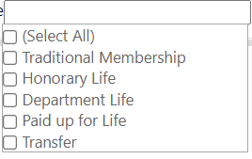
Current Roster
Displays members who are currently assigned to your post. Includes expired and deceased.
Status
Mailing Status
Membership Type
Notes:
Status includes active and deceased. Deceased members will remain on the roster and can be filtered out by selecting active only.
<1> The next filter is mailing status. Mail status let’s you know if the mailing address on file is good or flagged as undeliverable. Members with undeliverable status do not receive The American Legion Magazine, renewal notices, or any mailings from National Headquarters. Contact those members, if possible, to collect a valid mailing address and update. Updating an address that marked as undeliverable will remove the flag. If a member states the address on file is good, contact National Customer Service to remove the flag.
<2> Membership type includes traditional 1-year renewal, honorary life, department life, paid up for life and if the member is a current transfer.
After all data fields have been filled, click View Report. <3>

Slide 16
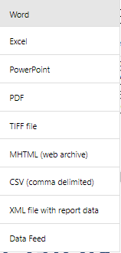
Current Roster
Displays members who are currently assigned to your post. Includes expired and deceased.
.
Notes:
The roster includes status, paid year, contact information, conflict, continuous years, branch of service, date of birth and membership type. Using the export Icon, export to an Excel document. <1>

Slide 17
Reports and Labels
Notes:
Legion members that renew online can be identified using the Member Online Renewals Report.
Online renewal is available for Legion and Sons of the American Legion membership.
Click on the blue hyperlink, or report name, to begin the members online renewal report.

Slide 18
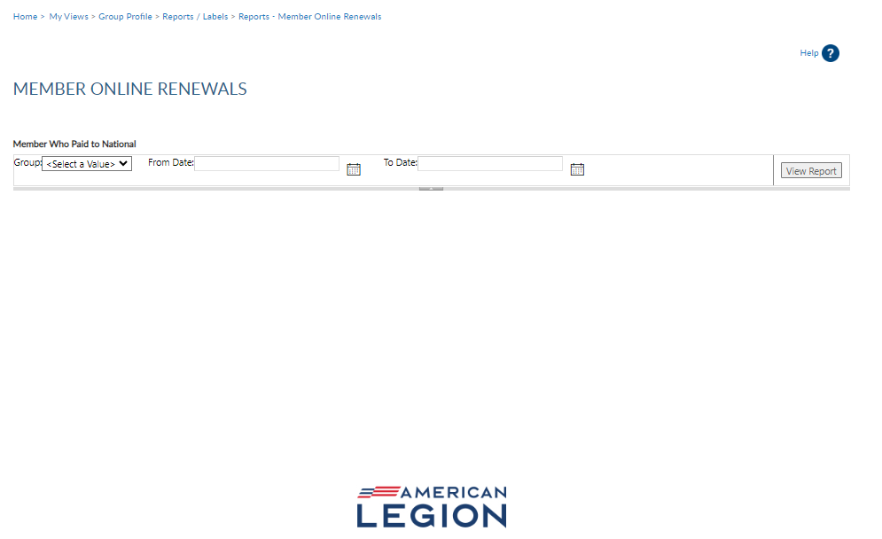
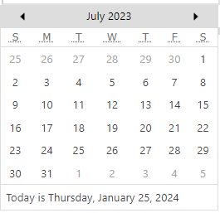
Member Online Renewal
Lists member paid online through national headquarters.
Notes:
<1> Group selection is required. Date range selection is updated by clicking on the calendar icon. Use the left and right arrows to navigate by month and year. Click on the date in the calendar to set. <2> Click View Report to generate listing.

Slide 19
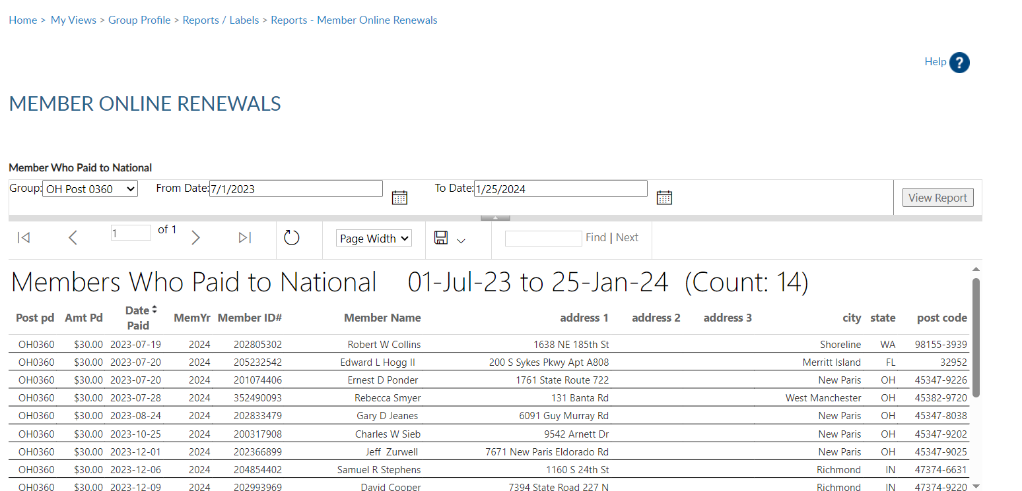
Member Online Renewal
Lists member paid online through national headquarters.
Notes:
This report provides the total count with names, member id#, date and renewal year. The amount paid displays the total amount of dues collected by the member, as reported on the annual post data report. When a member renews online, National collects post dues, and sends all others to the department to distribute.
If the post dues do not cover the minimum of national plus department, online renewal will not be available and result in an error message if the member attempts online renewal. All posts and squadrons are required to submit a Post/Squadron data form to their departments. This form includes dues rates and renewal remittance information.
The export icon <1> is used to print and save reports. Reports are not saved within the report writer.

Slide 20
Reports and Labels
Notes:
The next report is Roster Updates. This report helps identify members who have transferred in and out of your post or squadron, new joins and other updates made on the member record.

Slide 21
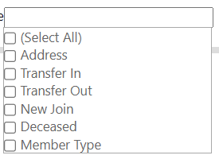
Roster Updates
Updates to member information for address, deceased status, transfer information and new members (new join).
Notes:
Select your group . Define date range using the calendar icons <1> will allow you define date parameters. Select update type <2>. After all filters are entered <3> View Report to generate.

Slide 22
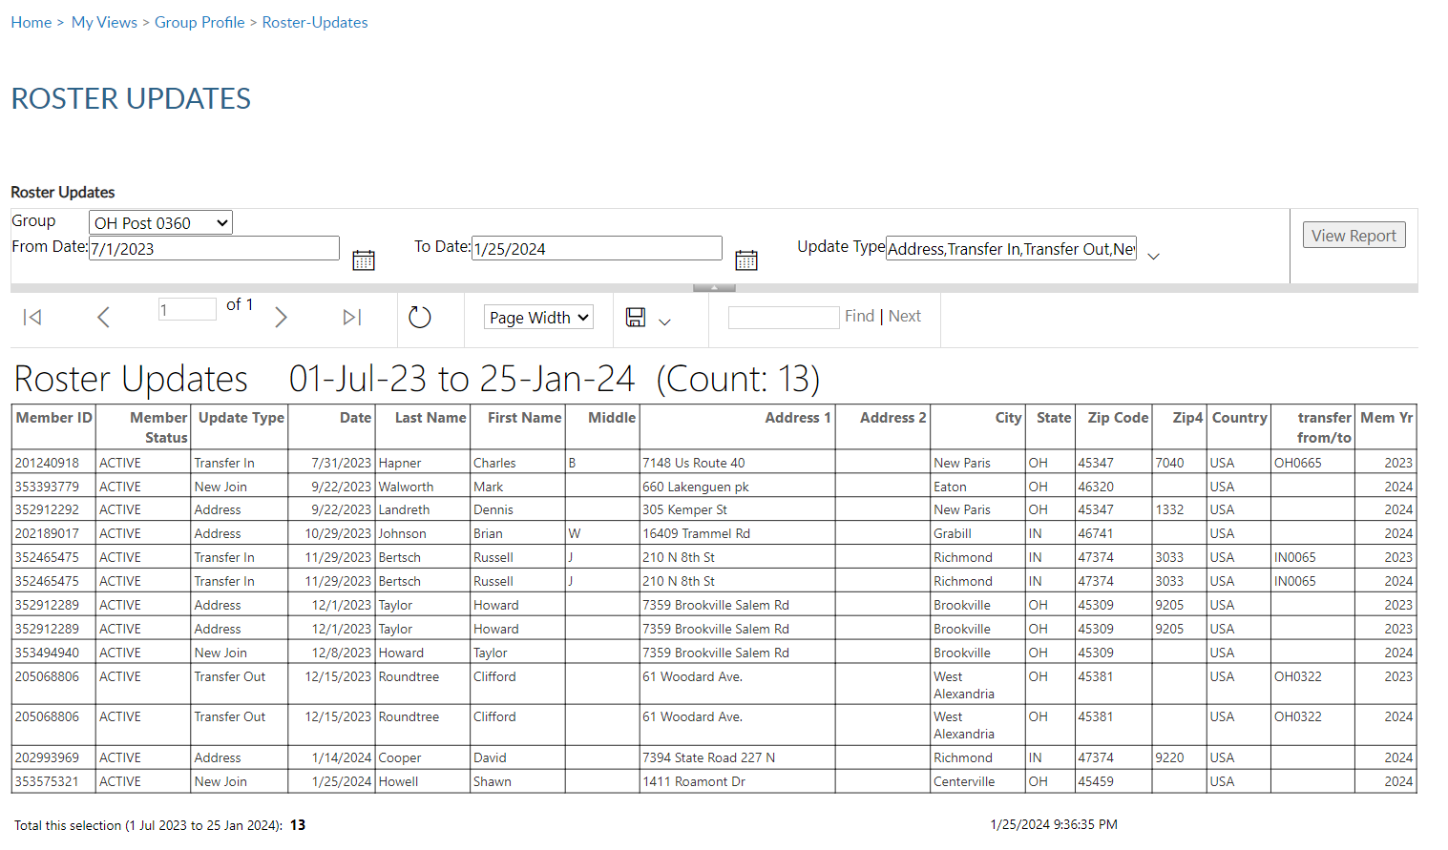
Roster Updates
Updates to member information for address, deceased status, transfer information and new members (new join).
Notes:
To print or save, export to an Excel Document or PDF.

Slide 23
Reports and Labels
Notes:
View member dues history displays payment information from 2011 to present.

Slide 24
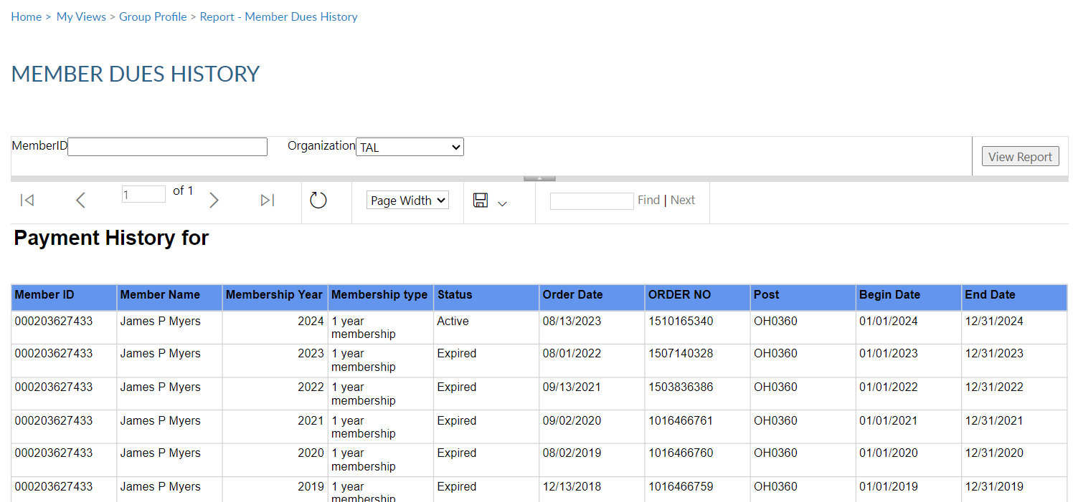
Member Dues History
Displays member payments from 2011 to current.
9-digit ID
Notes:
<1>Enter the 9-digit membership number <2> , organization, <3> and click View Report <3>. Use the export icon to save or print. <4>

Slide 25
Member Dues History
Displays member payments from 2011 to current.
9-digit ID
Notes:
Use the export icon to save or print. <4>

Slide 26
Reports and Labels
Notes:
The Paid Members report is the report corresponding with Department membership reports. It includes all members paid for the current year, even if they transferred out.

Slide 27
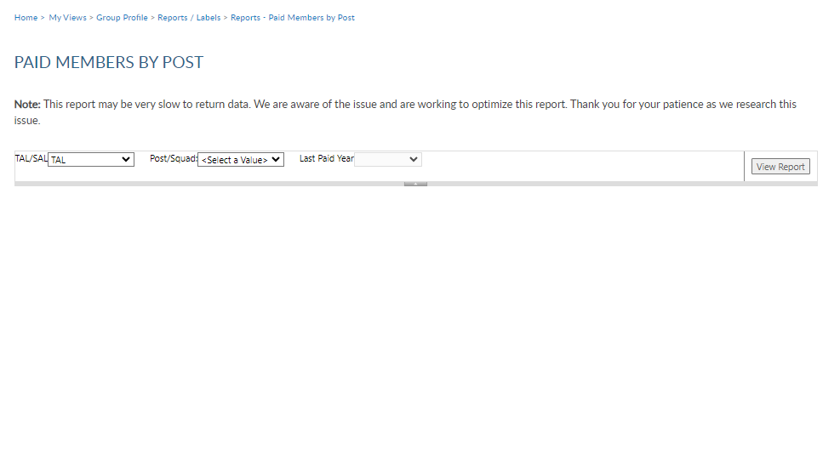
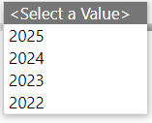
Paid Members
Paid members for the current membership year. Includes members who paid yet transferred out.
Notes:
Enter organization. <1> group <2> and last paid year <3> and View Report <4>.

Slide 28
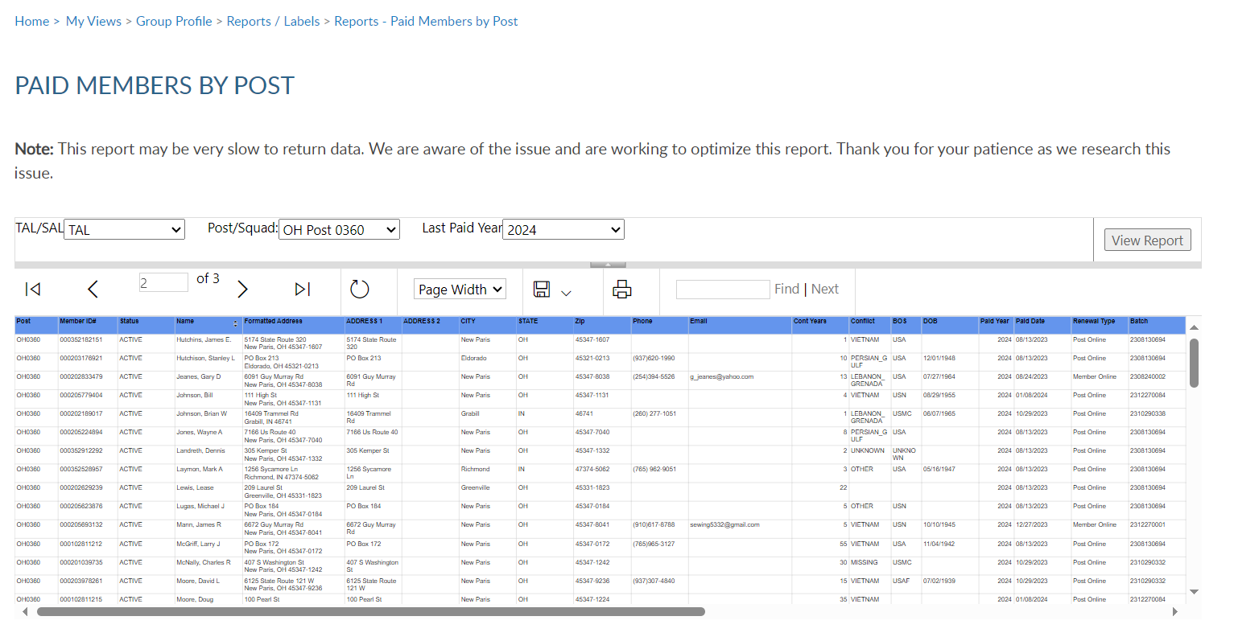
Paid Members
Paid members for the current membership year. Includes members who paid yet transferred out.
Notes:
This report provides members paid to the post, even if transferred out. <1> The export icon allows you to view or print.

Slide 29
Reports and Labels
Notes:
3x10 labels produce a 30 per sheet label that fits Avery 5160 or any 30/sheet blank labels.
Click on the blue report name to enter data filters and create labels.

Slide 30
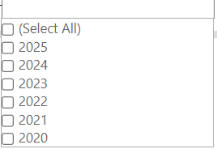
Mailing Labels
30 per sheet mailing labels for LGN and SAL members.
Notes:
Filtering options allows you to define the members included in labels. Deceased and members flagged as undeliverable will be suppressed from mailing labels.
>1> The first step is to select the group. <2> Select the last paid year or multiple years. <3> Designate if you want your labels sorted by last name or zip code.
<4> After parameters are defined, View Report to continue.

Slide 31
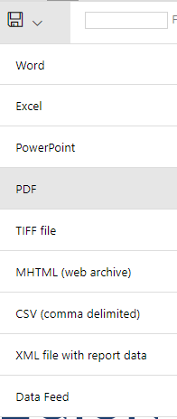
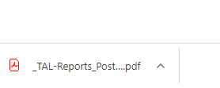
Mailing Labels
30 per sheet mailing labels for LGN and SAL members.
Name
Address
City, St, Zip
Name
Address
City,St, Zip
Name
Address
City,St, Zip
Notes:
The label display is not in 30/sheet format. Send the data to a PDF document selecting the export icon. <1> The export icon is used print and save all reports using the file types in the menu. PDF is the only selection that applies for labels. After you select PDF look for a tab to open the PDF generally located at the lower left of your window.

Slide 32
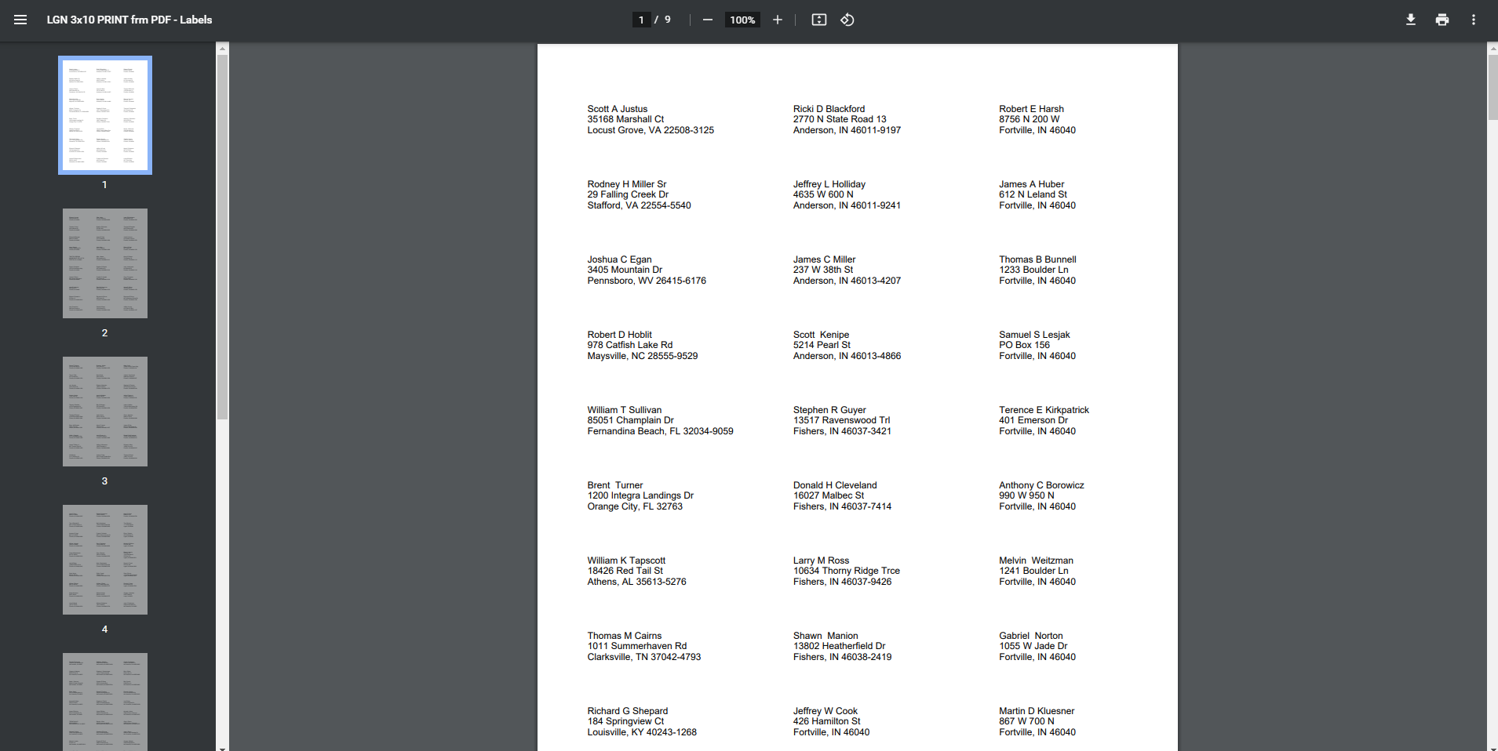
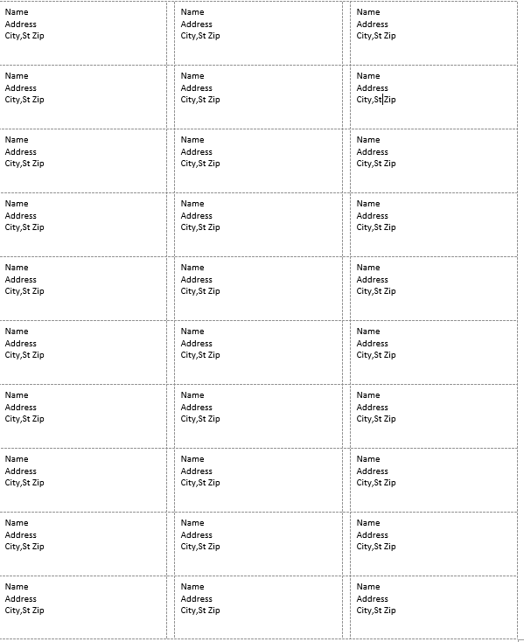
Notes:
The PDF opens to print labels. <1> Use the print icon to send to your printer.

Slide 33
Reports and Labels
Notes:
A renewal letter and labels are available to reach out to expired Legion and SAL members.

Slide 34
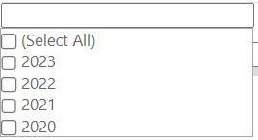
Renewal Letter & Labels
Pre-written custom letter inviting expired members to renew. Create labels for your letter using the same filter criteria.
Last Paid Year
Sort by
Notes:
Creating the letter begins with filters. Select the group first. <1> This populates contact name and title with commander information. <2> These fields can be modified by typing new text in the fields.
<3> Enter last paid year or multiple years, and sort option. <4> View Report to generate. <5>

Slide 35
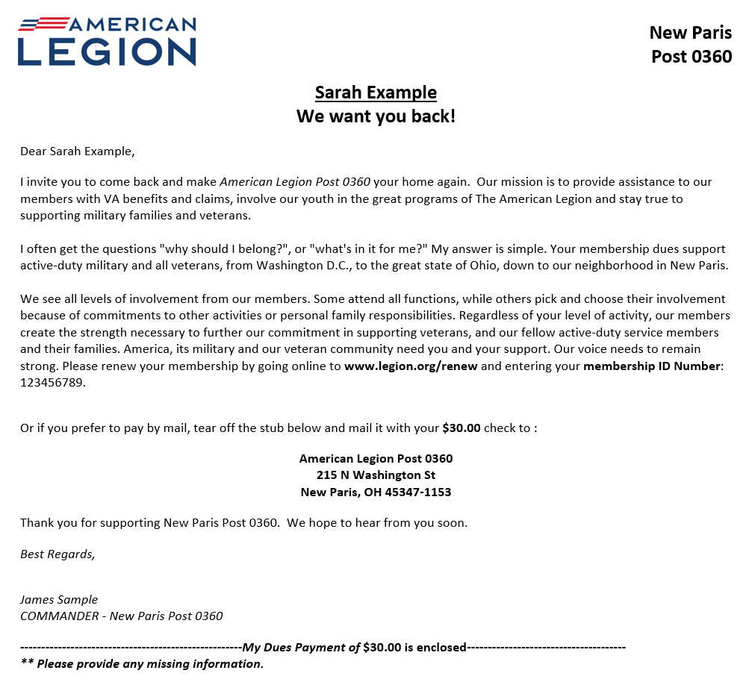
Notes:
The personalized letter generated to export to a PDF <1>.

Slide 36
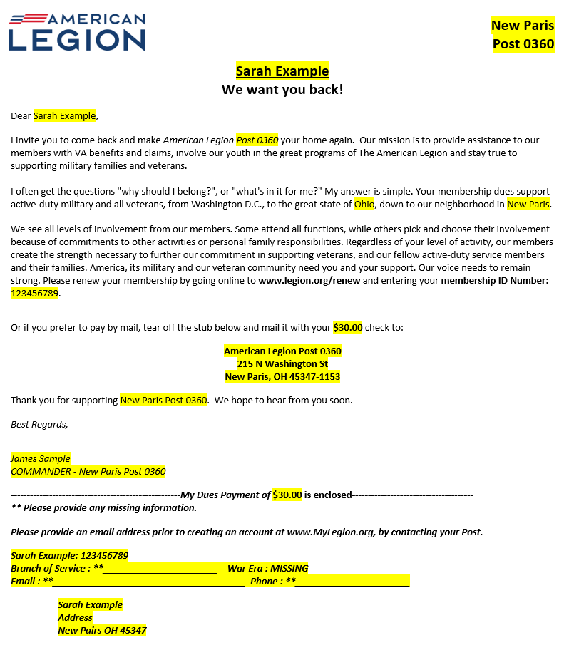
Notes:
The letter is personalized using member and post or squadron information including dues and dues remittance address.

Slide 37
Reports and Labels
Notes:
Labels for renewal letters are generated using the same process as 3x10 labels. <1> When selecting filters, enter the same filters as letters.

Slide 38
Reports and Labels
Radius + 1 zip search
Multi zip search
Notes:
To create a listing of HQs post members, begin in Reports and Labels – Find Members in My Area.
This report is only available to adjutants and commanders. Access to this report is not included with group administrator’s permission.
Find Members in my Area provides contact information for Legion members in your state headquarters post within a designated area defined by zip code.

Slide 39
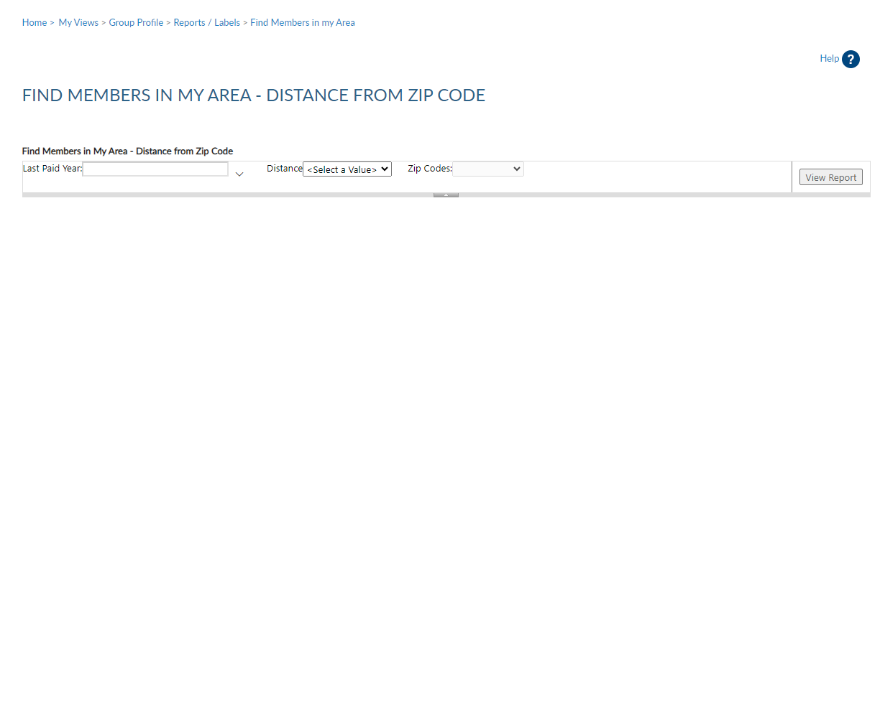
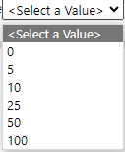
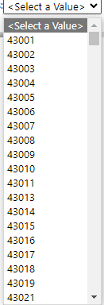
Notes:
When using this report, enter last paid year, distance, and zip code. Only one zip code can be selected and all zips are within the state. This report is not to be used to locate members in other departments. Click ”View Report” to generate.

Slide 40
Notes:
The report generates and is sorted alphabetically. It includes contact information on file at national headquarters. This listing can be exported to save or print using the export icon. <1>

Slide 41
Reports and Labels
Notes:
Locate members who have moved into your area within the last 46 days using the Project Stay Active listing.

Slide 42
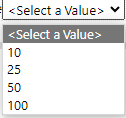
Project Stay Active
Locate members who have moved into your area within the last 45 days.
Notes:
Choose zip code and distance and View Report.

Slide 43
Project Stay Active
Locate members who have moved into your area within the last 45 days.
Notes:
The listing provides contact information to welcome the member to the community, introduce them to your post or squadron and invite them to transfer. This report will display members who have reported an address change within the last 45 days.

Slide 44
Reports and Labels
Notes:
The MyLegion Access report allows you to view who has permission to group profile.

Slide 45
MyLegion Access
Displays members who have access to Group Profile and permission level.
Notes:
Select group <1> and View Report. <2> The report displays all members who have access to the selected group along with permission settings. Adjutants and Commanders can add, edit and remove permissions or you can contact your state headquarters. As with all reports, use the export icon to print or save the report. <3>

Slide 46
Reports and Labels
Notes:
District and County groups can generate a Post/Squadron Health Status report. This report is designed to view transmittal and CPR/CSR activity for posts and squadrons.

Slide 47
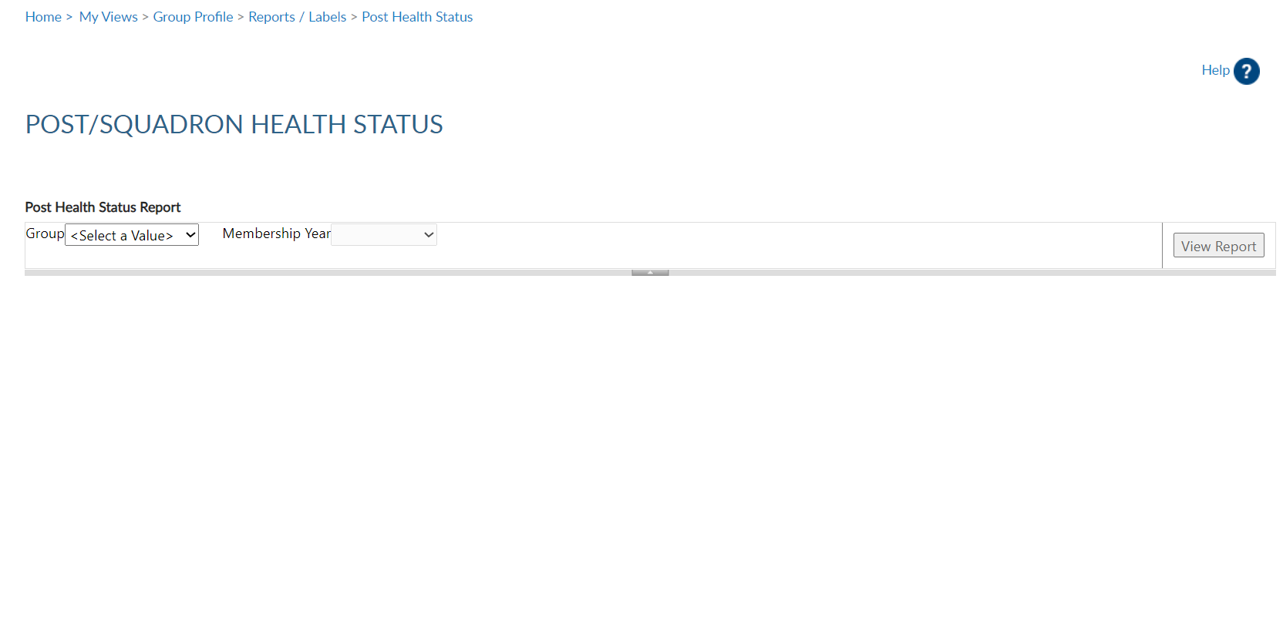
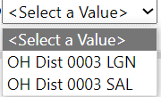
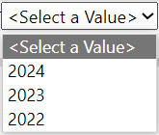
Post/Sqdn Health Status
Track post and squadron online membership processing activity, CPR reporting, and mailing status.
Notes:
Select group <1> and <2> last paid year and View Report <3>

Slide 48
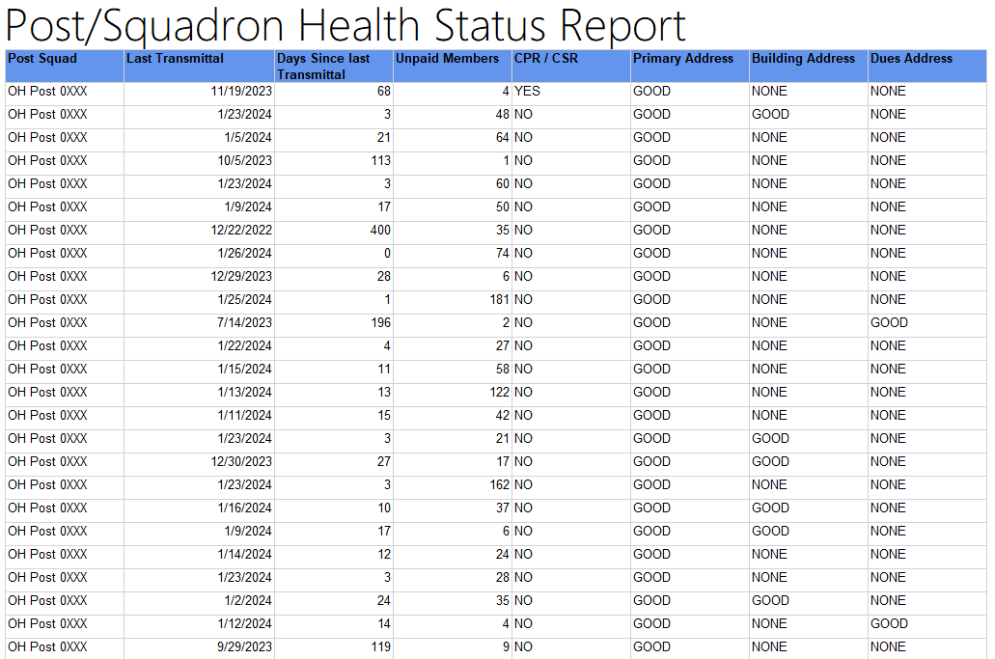
Post/Sqdn Health Status
Track post and squadron online membership processing activity, CPR reporting, and mailing status.
Notes:
View the post or squadron status for membership transmittals. Last transmittal date includes any transmittal submitted online or mailed through the department.
The last paid year column tallies unpaid memberships for the year selected and any prior years if a renewal is available.
CPR / CSR status lets you know if one has been submitted for the reporting year.
If you find any updates to a post record address, please contact your department headquarters.

Slide 49
Online Help
Notes:
Online help is available from the top Menu “Find Help”.
Step by step instructions, videos and training presentations will assist with how to manage groups in MyLegion.

Slide 50
Online Help
Notes:
Step by step instructions, videos and training presentations will assist with how to manage groups in MyLegion.

Slide 51
MyLegion Support
Email:
mylegion@legion.org
Phone:
833.253.9995
Notes:
Your National support staff is available Monday through Friday, 8-4:30pm Eastern.

